Slide 1
Reference (1)
Jeff (CHI-HSUAN HO)
The subsequent slides only showcase a few parts of the work materials and results.

Slide 2
Bioinformatics Analyses – Genotyping (GT), APT, CPT
Jeff (CHI-HSUAN HO)

Slide 3
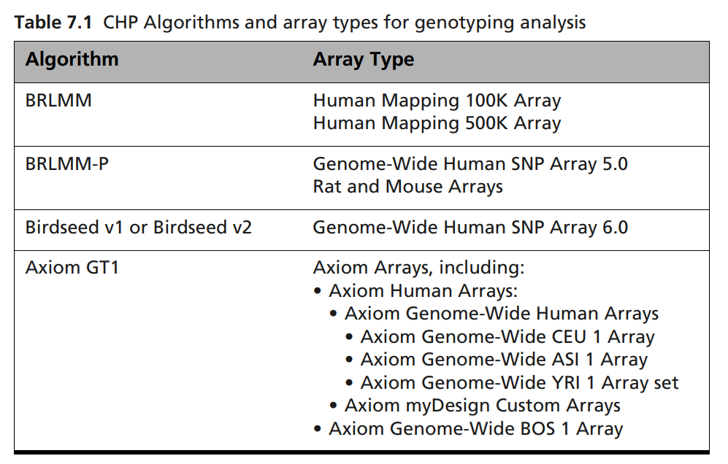
Genotyping Analysis Development and Deployment
Genotyping Procedure Documents for Each Chip
( )
GTC v4.2 P/N 702982 Rev. 3

Slide 4
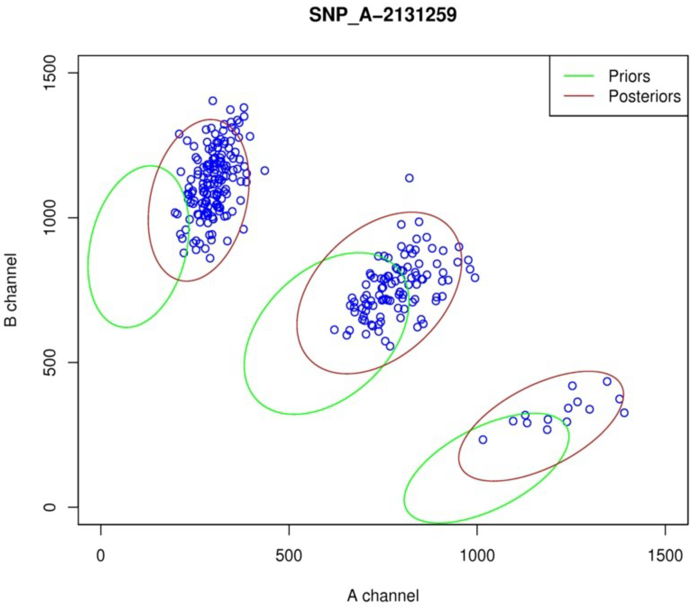
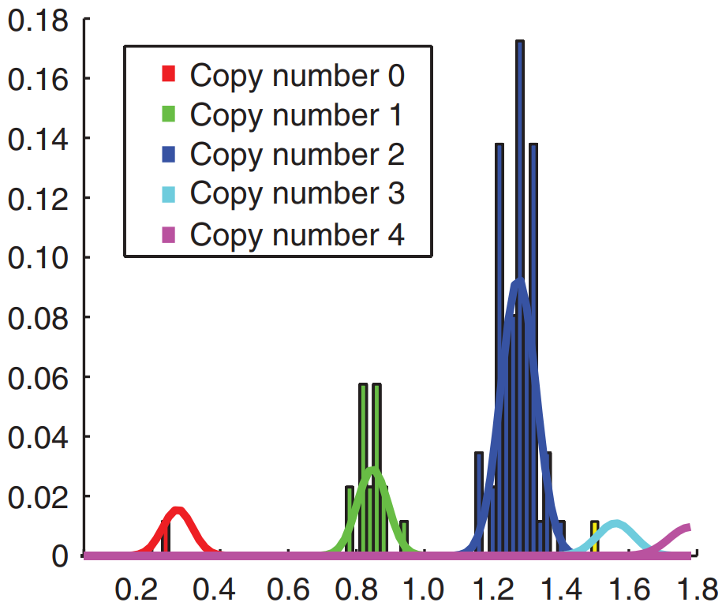

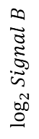
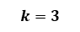
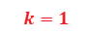
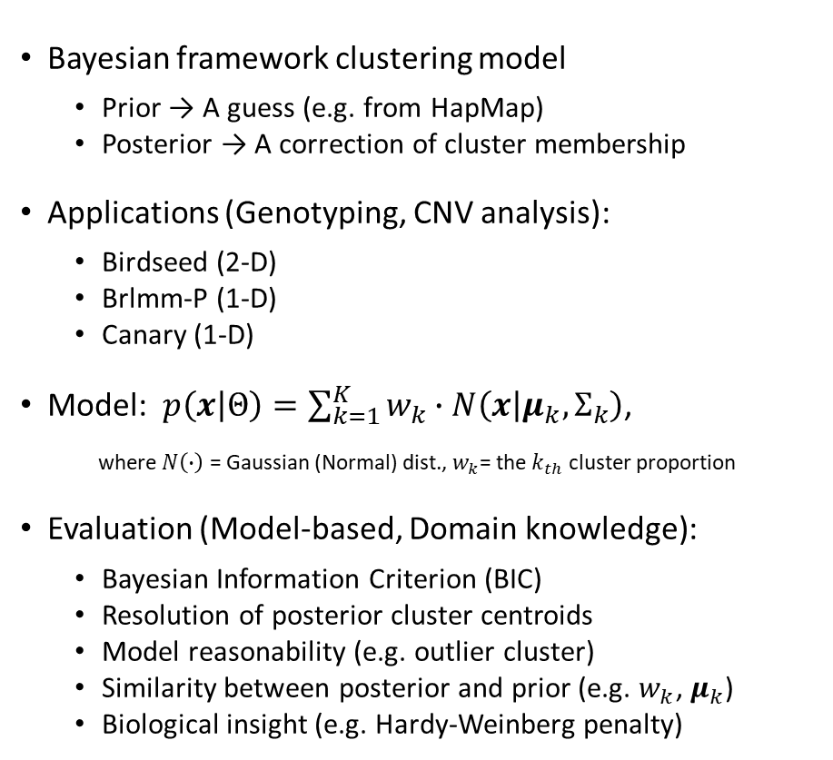
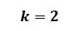

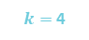
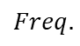
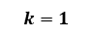

Gaussian Mixture Model (GMM)
SNP_A-2131259
$$k=1$$
Bayesian framework clustering model
Prior → A guess (e.g. from HapMap)
Posterior → A correction of cluster membership
Applications (Genotyping, CNV analysis):
Birdseed (2-D)
Brlmm-P (1-D)
Canary (1-D)
Model: $p\left(x | Θ\right)=\sum_{k=1}^{K}{w_{k}}∙N\left(x | μ_{k}, Σ_{k}\right)$,
where $N\left(∙\right)$ = Gaussian (Normal) dist., $w_{k}$= the $k_{th}$ cluster proportion
Evaluation (Model-based, Domain knowledge):
Bayesian Information Criterion (BIC)
Resolution of posterior cluster centroids
Model reasonability (e.g. outlier cluster)
Similarity between posterior and prior (e.g. $w_{k}$, $μ_{k}$)
Biological insight (e.g. Hardy-Weinberg penalty)
$$k=2$$
0
8.9
9.9
10.5
$$\log_{2}{Signal B}$$
$$k=3$$
0
8.9
9.9
10.5
$$k=3$$
$$Freq.$$
$$k=2$$
$$k=1$$
$k=$ 4
$$\log_{2}{Signal A}$$

Slide 5
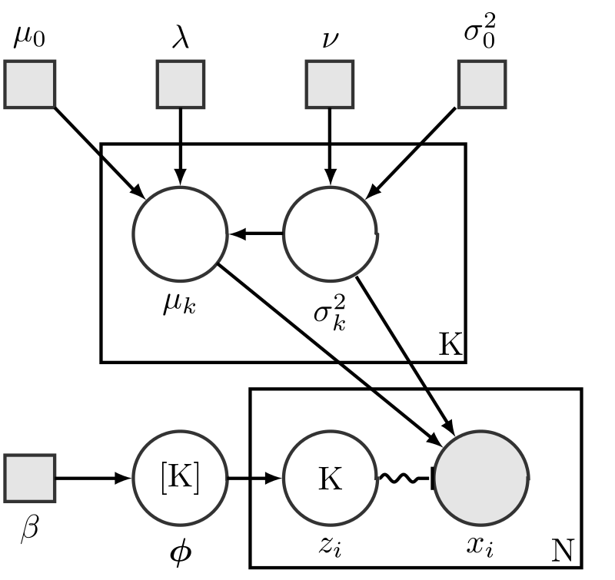
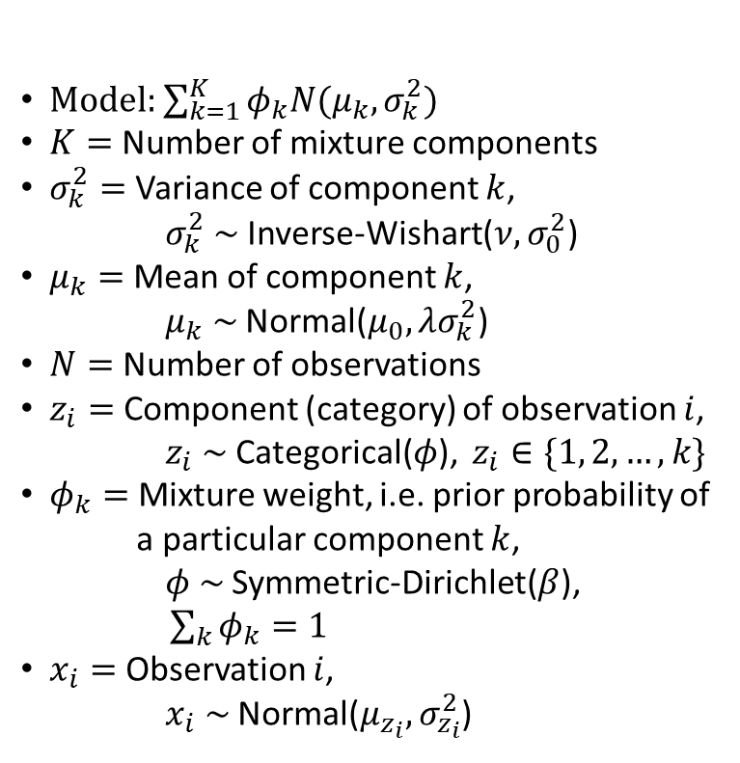
Bayesian Gaussian Mixture Model
Model: $\sum_{k=1}^{K}{φ_{k}N(μ_{k}, σ_{k}^{2})}$
$K=$ Number of mixture components
$σ_{k}^{2}=$ Variance of component $k$,
$σ_{k}^{2} \sim$ Inverse-Wishart($ν,σ_{0}^{2}$)
$μ_{k}=$ Mean of component $k$,
$μ_{k} \sim$ Normal($μ_{0},λσ_{k}^{2}$)
$N=$ Number of observations
$z_{i}=$ Component (category) of observation $i$,
$z_{i} \sim$ Categorical($φ$), $z_{i}∈\{1, 2, …, k\}$
$φ_{k}=$ Mixture weight, i.e. prior probability of
a particular component $k$,
$φ \sim$ Symmetric-Dirichlet($β$),
$\sum_{k}{φ_{k}}=1$
$x_{i}=$ Observation $i$,
$x_{i} \sim$ Normal($μ_{z_{i}},σ_{z_{i}}^{2}$)

Slide 6
Genotyping Analysis Development and Distribution
AxiomGT Framework
Training samples
Test samples
Auxiliary
Params
Data Loader
CDF
Data Loader
Target Sketch Estimation
MDL
Quantile Normalization
Quantile Normalization
Allele Summarization
Probe-set List
Allele Summarization
Signal Space Transformation
Signal Space Transformation
AxiomGT <Call>
AxiomGT <Train>
MDL
Genotyping Results
Web Browser
Notes:
Channel name caused by hdf5
VCF definition failure: correct => A: ref, B: alt
Image convert to heatmap: Y need to be inversed.

Slide 7
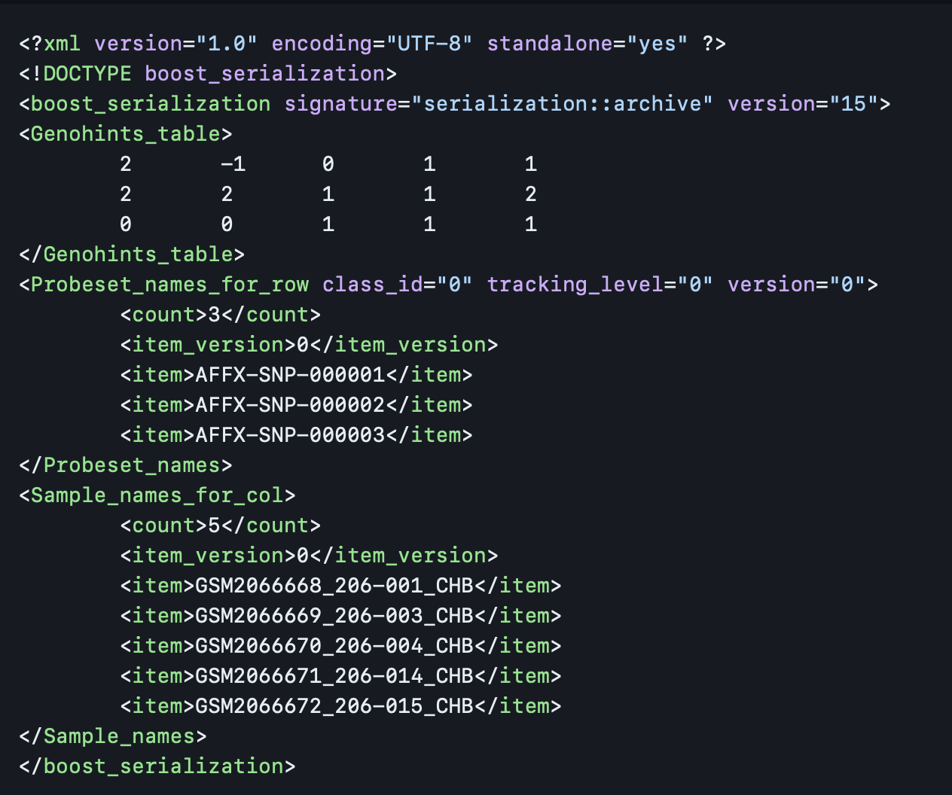
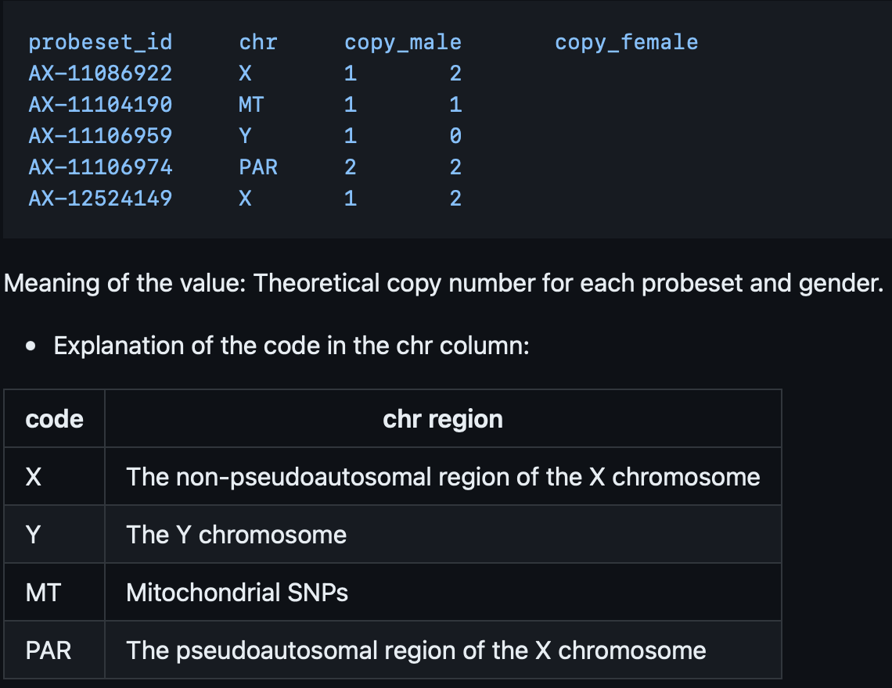
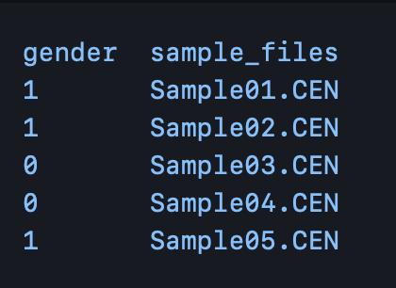
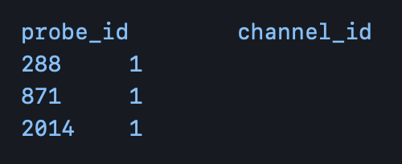
Genotyping Analysis Development and Distribution
Auxiliary
Params
Genotype
Special SNPs
Genders
Sex Probes
Notes:
Channel name caused by hdf5
VCF definition failure: correct => A: ref, B: alt
Image convert to heatmap: Y need to be inversed.

Slide 8
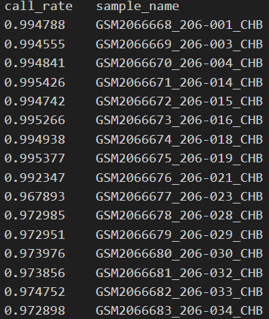
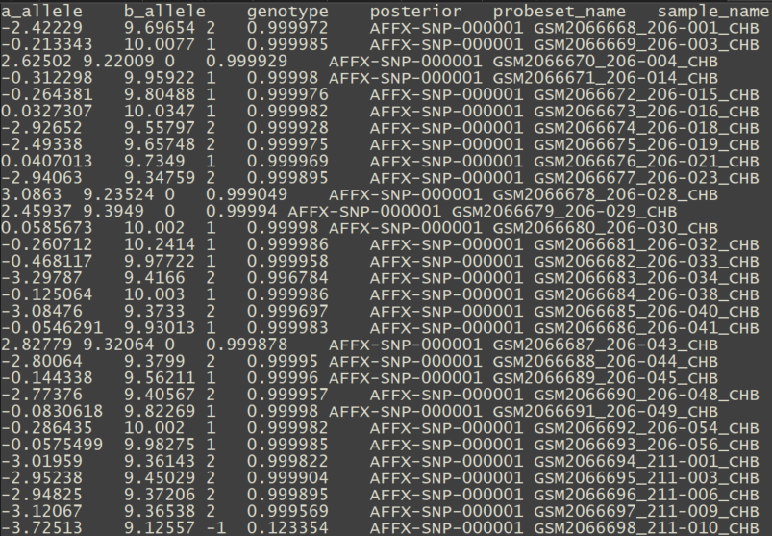
Genotyping Analysis Development and Distribution
Genotyping Results
Call Rate
Genotype Inference Report
Notes:
Channel name caused by hdf5
VCF definition failure: correct => A: ref, B: alt
Image convert to heatmap: Y need to be inversed.

Slide 9
Genotyping Analysis Development and Distribution
Training samples (CEL)
AxiomGT1 Algo (bayes_label)
initialize_bins
(x -> bins domain)
Integratebrlmmoverlabelings (bins domain)
labels_two_posterior
(bins domain)
make_two_calls
(bins domain params results
-> x calls)
Data and Parameters Loader
Target Sketch Estimation
Quantile Normalization
Probe Sets Summarization
Alleles Summarization
Signal Space Transformation (MvA)
GMM Bayesian Update
Genotype Calls and Confidences
Notes:
Channel name caused by hdf5
VCF definition failure: correct => A: ref, B: alt
Image convert to heatmap: Y need to be inversed.

Slide 10
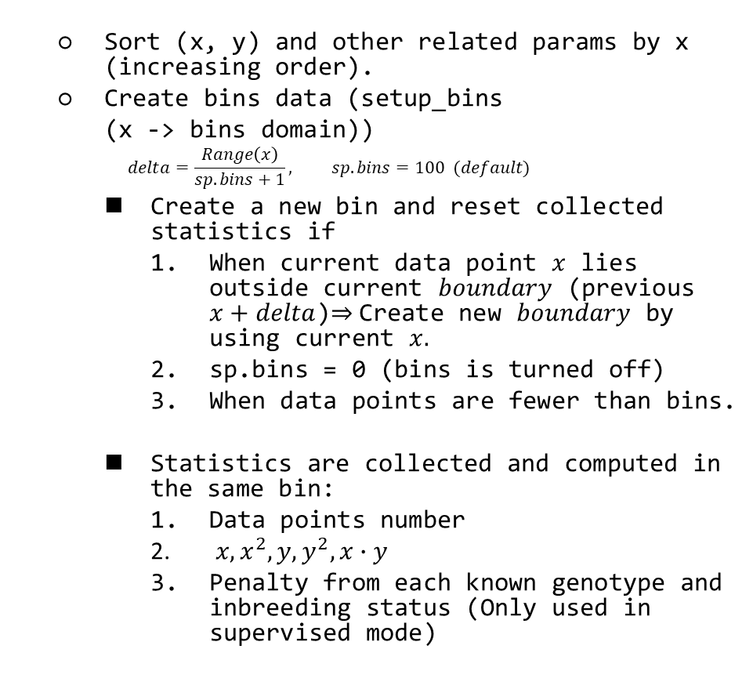
Genotyping Analysis Development and Distribution
Training samples (CEL)
Sort (x, y) and other related params by x (increasing order).
Create bins data (setup_bins
(x -> bins domain))
$$delta=\frac{Range\left(x\right)}{sp.bins+1}, sp.bins=100 (default)$$
Create a new bin and reset collected statistics if
When current data point $x$ lies outside current $boundary$ (previous $x+delta$)$⇒$Create new $boundary$ by using current $x.$
sp.bins = 0 (bins is turned off)
When data points are fewer than bins.
Statistics are collected and computed in the same bin:
Data points number
$x,x^{2}, y, y^{2}, x∙y$
Penalty from each known genotype and inbreeding status (Only used in supervised mode)
Data and Parameters Loader
Target Sketch Estimation
Quantile Normalization
Probe Sets Summarization
Alleles Summarization
Signal Space Transformation (MvA)
GMM Bayesian Update
Genotype Calls and Confidences

Slide 11
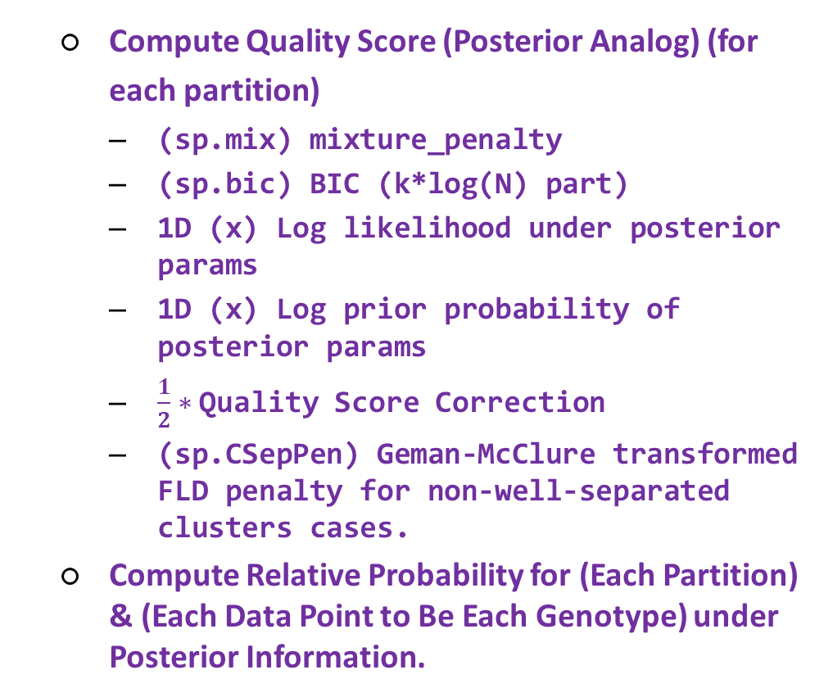
Genotyping Analysis Development and Distribution
Training samples (CEL)
Compute Quality Score (Posterior Analog) (for each partition)
(sp.mix) mixture_penalty
(sp.bic) BIC (k*log(N) part)
1D (x) Log likelihood under posterior params
1D (x) Log prior probability of posterior params
$\frac{1}{2}∗$ Quality Score Correction
(sp.CSepPen) Geman-McClure transformed FLD penalty for non-well-separated clusters cases.
Compute Relative Probability for (Each Partition) & (Each Data Point to Be Each Genotype) under Posterior Information.
Data and Parameters Loader
Target Sketch Estimation
Quantile Normalization
Probe Sets Summarization
Alleles Summarization
Signal Space Transformation (MvA)
GMM Bayesian Update
Genotype Calls and Confidences

Slide 12
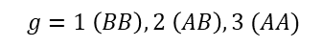
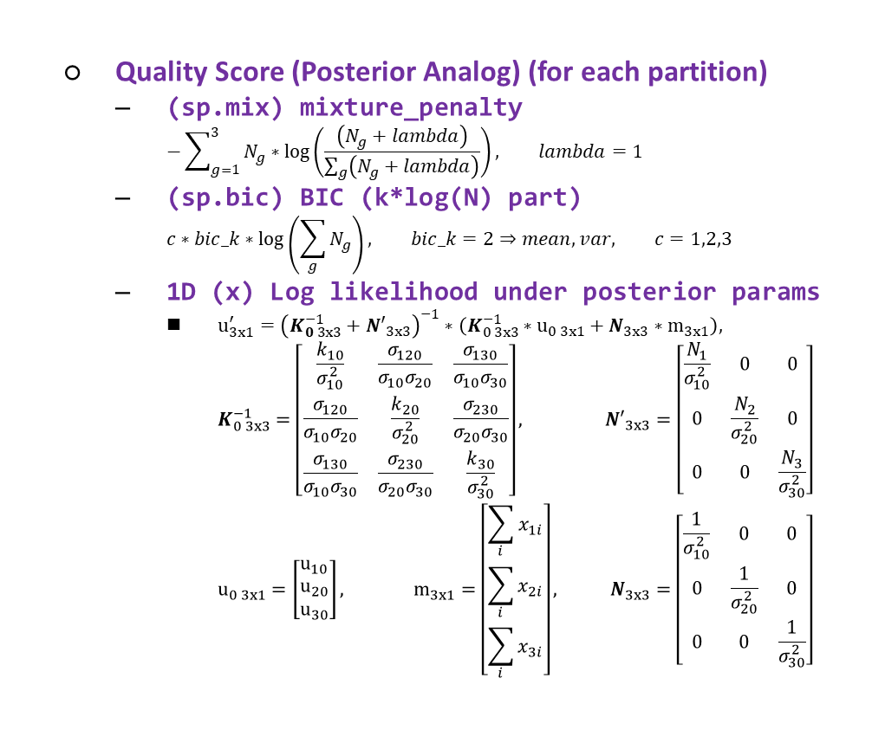
Genotyping Analysis Development and Distribution
Training samples (CEL)
Quality Score (Posterior Analog) (for each partition)
(sp.mix) mixture_penalty
$$−\sum_{g=1}^{3}{N_{g}∗\log\left(\frac{\left(N_{g}+lambda\right)}{\sum_{g}{\left(N_{g}+lambda\right)}}\right)}, lambda=1$$
(sp.bic) BIC (k*log(N) part)
$$c∗bic_k∗\log\left(\sum_{g}{N_{g}}\right), bic_k=2⇒mean, var, c=1,2,3$$
1D (x) Log likelihood under posterior params
$u_{3x1}^{′}={\left(K_{0 3x3}^{−1}+{N′}_{3x3}\right)}^{−1}∗\left(K_{0 3x3}^{−1}∗u_{0 3x1}+N_{3x3}∗m_{3x1}\right),$
$$K_{0 3x3}^{−1}=\left[\begin{matrix}\frac{k_{10}}{σ_{10}^{2}} & \frac{σ_{120}}{σ_{10}σ_{20}} & \frac{σ_{130}}{σ_{10}σ_{30}} \\ \frac{σ_{120}}{σ_{10}σ_{20}} & \frac{k_{20}}{σ_{20}^{2}} & \frac{σ_{230}}{σ_{20}σ_{30}} \\ \frac{σ_{130}}{σ_{10}σ_{30}} & \frac{σ_{230}}{σ_{20}σ_{30}} & \frac{k_{30}}{σ_{30}^{2}}\end{matrix}\right], {N′}_{3x3}=\left[\begin{matrix}\frac{N_{1}}{σ_{10}^{2}} & 0 & 0 \\ 0 & \frac{N_{2}}{σ_{20}^{2}} & 0 \\ 0 & 0 & \frac{N_{3}}{σ_{30}^{2}}\end{matrix}\right]$$
$$u_{0 3x1}=\left[\begin{matrix}u_{10} \\ u_{20} \\ u_{30}\end{matrix}\right], m_{3x1}=\left[\begin{matrix}\sum_{i}{x_{1i}} \\ \sum_{i}{x_{2i}} \\ \sum_{i}{x_{3i}}\end{matrix}\right], N_{3x3}=\left[\begin{matrix}\frac{1}{σ_{10}^{2}} & 0 & 0 \\ 0 & \frac{1}{σ_{20}^{2}} & 0 \\ 0 & 0 & \frac{1}{σ_{30}^{2}}\end{matrix}\right]$$
Data and Parameters Loader
$$g=1 \left(BB\right),2 \left(AB\right),3 (AA)$$
Target Sketch Estimation
Quantile Normalization
Probe Sets Summarization
Alleles Summarization
Signal Space Transformation (MvA)
GMM Bayesian Update
Genotype Calls and Confidences

Slide 13
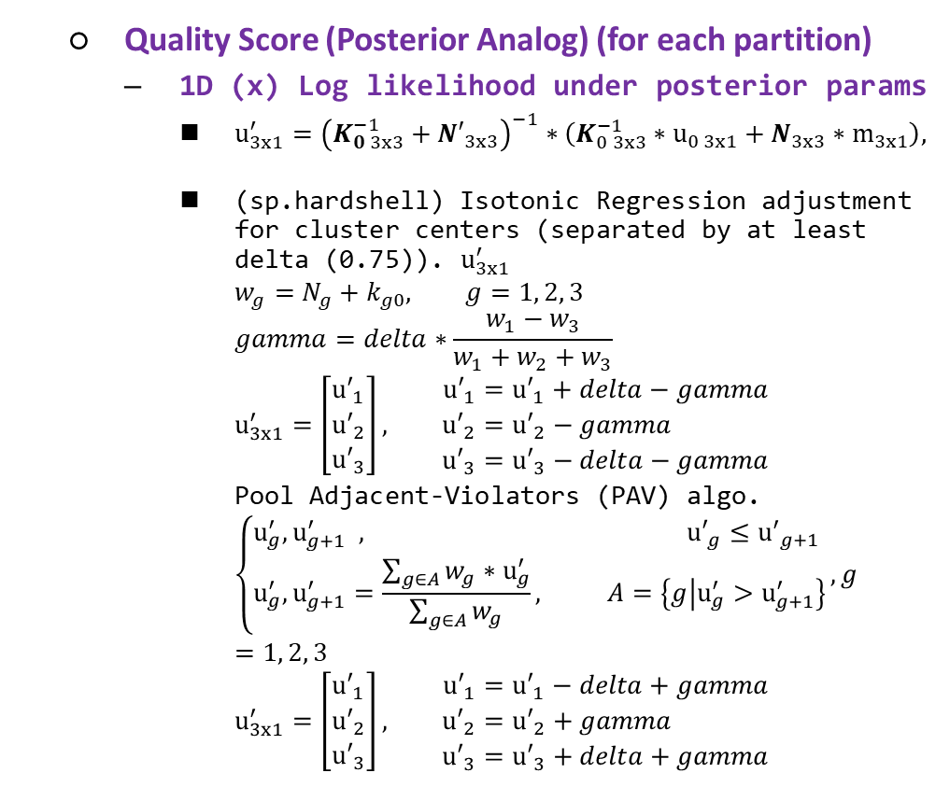
Genotyping Analysis Development and Distribution
Training samples (CEL)
Quality Score (Posterior Analog) (for each partition)
1D (x) Log likelihood under posterior params
$u_{3x1}^{′}={\left(K_{0 3x3}^{−1}+{N′}_{3x3}\right)}^{−1}∗\left(K_{0 3x3}^{−1}∗u_{0 3x1}+N_{3x3}∗m_{3x1}\right),$
(sp.hardshell) Isotonic Regression adjustment for cluster centers (separated by at least delta (0.75)). $u_{3x1}^{′}$
$$w_{g}=N_{g}+k_{g0}, g=1, 2, 3$$
$$gamma=delta∗\frac{w_{1}−w_{3}}{w_{1}+w_{2}+w_{3}}$$
$$u_{3x1}^{′}=\left[\begin{matrix}{u′}_{1} \\ {u′}_{2} \\ {u′}_{3}\end{matrix}\right], \begin{matrix}{u′}_{1}={u′}_{1}+delta−gamma \\ {u′}_{2}={u′}_{2}−gamma \\ {u′}_{3}={u′}_{3}−delta−gamma\end{matrix}$$
Pool Adjacent-Violators (PAV) algo.
$$\left\{\begin{aligned}u_{g}^{′}, u_{g+1}^{′} , {u′}_{g}≤{u^{′}}_{g+1} \\ u_{g}^{′}, u_{g+1}^{′}=\frac{\sum_{g∈A}{w_{g}}∗u_{g}^{′}}{\sum_{g∈A}{w_{g}}}, A=\left\{g | u_{g}^{′}>u_{g+1}^{′}\right\}\end{aligned}\right., g=1, 2, 3$$
$$u_{3x1}^{′}=\left[\begin{matrix}{u′}_{1} \\ {u′}_{2} \\ {u′}_{3}\end{matrix}\right], \begin{matrix}{u′}_{1}={u′}_{1}−delta+gamma \\ {u′}_{2}={u′}_{2}+gamma \\ {u′}_{3}={u′}_{3}+delta+gamma\end{matrix}$$
Data and Parameters Loader
Target Sketch Estimation
Quantile Normalization
Probe Sets Summarization
Alleles Summarization
Signal Space Transformation (MvA)
GMM Bayesian Update
Genotype Calls and Confidences

Slide 14
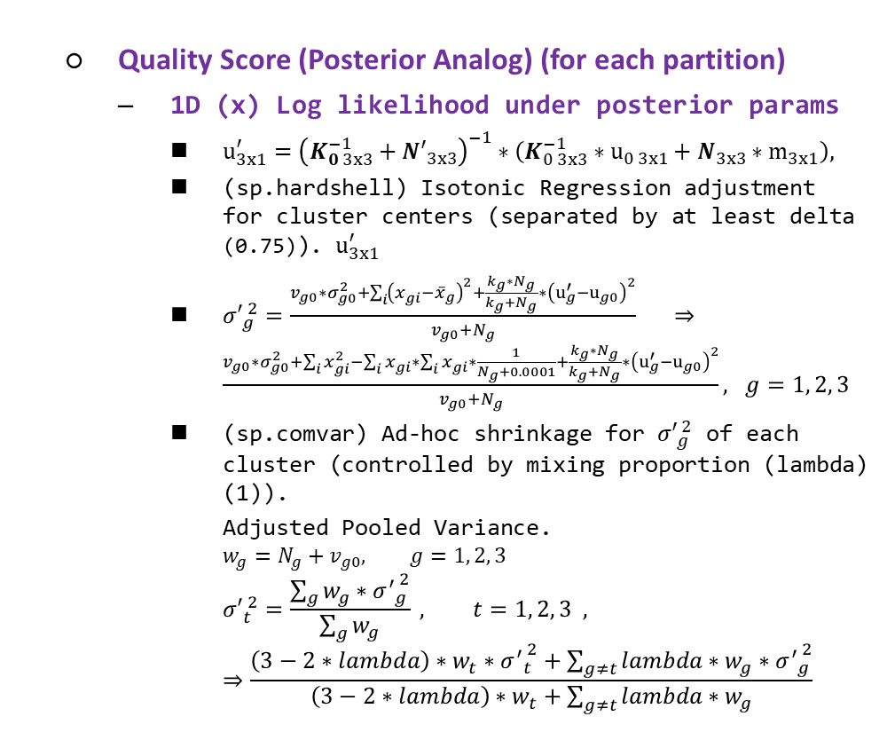
Genotyping Analysis Development and Distribution
Training samples (CEL)
Quality Score (Posterior Analog) (for each partition)
1D (x) Log likelihood under posterior params
$u_{3x1}^{′}={\left(K_{0 3x3}^{−1}+{N′}_{3x3}\right)}^{−1}∗\left(K_{0 3x3}^{−1}∗u_{0 3x1}+N_{3x3}∗m_{3x1}\right),$
(sp.hardshell) Isotonic Regression adjustment for cluster centers (separated by at least delta (0.75)). $u_{3x1}^{′}$
${σ′}_{g}^{ 2}=\frac{v_{g0}∗σ_{g0}^{2}+\sum_{i}{{\left(x_{gi}{−\overline{x}}_{g}\right)}^{2}}+\frac{k_{g}∗N_{g}}{k_{g}+N_{g}}∗{\left(u_{g}^{′}−u_{g0}\right)}^{2}}{v_{g0}+N_{g}} ⇒\frac{v_{g0}∗σ_{g0}^{2}+\sum_{i}{x_{gi}^{2}}−\sum_{i}{x_{gi}}∗\sum_{i}{x_{gi}}∗\frac{1}{N_{g}+0.0001}+\frac{k_{g}∗N_{g}}{k_{g}+N_{g}}∗{\left(u_{g}^{′}−u_{g0}\right)}^{2}}{v_{g0}+N_{g}}, g=1, 2, 3$
(sp.comvar) Ad-hoc shrinkage for ${σ′}_{g}^{ 2}$ of each cluster (controlled by mixing proportion (lambda) (1)).
Adjusted Pooled Variance.
$$w_{g}=N_{g}+v_{g0}, g=1, 2, 3$$
$${σ′}_{t}^{ 2}=\frac{\sum_{g}{w_{g}∗{σ^{′}}_{g}^{ 2}}}{\sum_{g}{w_{g}}} , t=1, 2, 3 , ⇒\frac{\left(3−2∗lambda\right)∗w_{t}∗{σ^{′}}_{t}^{ 2}+\sum_{g≠t}{lambda∗w_{g}∗{σ^{′}}_{g}^{ 2}}}{\left(3−2∗lambda\right)∗w_{t}+\sum_{g≠t}{lambda∗w_{g}}}$$
Data and Parameters Loader
Target Sketch Estimation
Quantile Normalization
Probe Sets Summarization
Alleles Summarization
Signal Space Transformation (MvA)
GMM Bayesian Update
Genotype Calls and Confidences

Slide 15
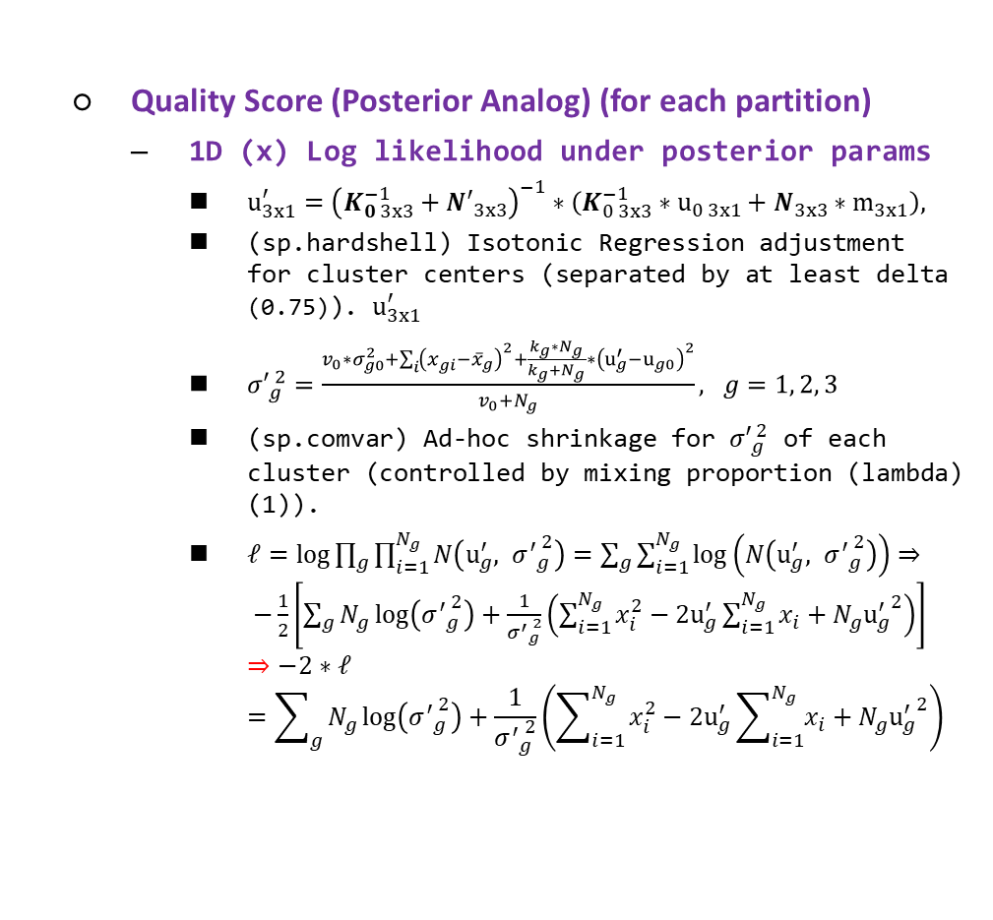
Genotyping Analysis Development and Distribution
Training samples (CEL)
Quality Score (Posterior Analog) (for each partition)
1D (x) Log likelihood under posterior params
$u_{3x1}^{′}={\left(K_{0 3x3}^{−1}+{N′}_{3x3}\right)}^{−1}∗\left(K_{0 3x3}^{−1}∗u_{0 3x1}+N_{3x3}∗m_{3x1}\right),$
(sp.hardshell) Isotonic Regression adjustment for cluster centers (separated by at least delta (0.75)). $u_{3x1}^{′}$
${σ′}_{g}^{ 2}=\frac{v_{0}∗σ_{g0}^{2}+\sum_{i}{{\left(x_{gi}{−\overline{x}}_{g}\right)}^{2}}+\frac{k_{g}∗N_{g}}{k_{g}+N_{g}}∗{\left(u_{g}^{′}−u_{g0}\right)}^{2}}{v_{0}+N_{g}}, g=1, 2, 3$
(sp.comvar) Ad-hoc shrinkage for ${σ′}_{g}^{ 2}$ of each cluster (controlled by mixing proportion (lambda) (1)).
$ℓ=log{\prod_{g}{\prod_{i=1}^{N_{g}}{N\left(u_{g}^{′}, {σ^{′}}_{g}^{ 2}\right)}}}=\sum_{g}{\sum_{i=1}^{N_{g}}{\log\left(N\left(u_{g}^{′}, {σ^{′}}_{g}^{ 2}\right)\right)}}⇒ −\frac{1}{2}\left[\sum_{g}{N_{g}\log\left({σ^{′}}_{g}^{ 2}\right)+\frac{1}{{σ^{′}}_{g}^{ 2}}\left(\sum_{i=1}^{N_{g}}{x_{i}^{2}}−2u_{g}^{′}\sum_{i=1}^{N_{g}}{x_{i}}+N_{g}{u_{g}^{′}}^{2}\right)}\right]$
$$⇒−2∗ℓ=\sum_{g}{N_{g}\log\left({σ^{′}}_{g}^{ 2}\right)+\frac{1}{{σ^{′}}_{g}^{ 2}}\left(\sum_{i=1}^{N_{g}}{x_{i}^{2}}−2u_{g}^{′}\sum_{i=1}^{N_{g}}{x_{i}}+N_{g}{u_{g}^{′}}^{2}\right)}$$
Data and Parameters Loader
Target Sketch Estimation
Quantile Normalization
Probe Sets Summarization
Alleles Summarization
Signal Space Transformation (MvA)
GMM Bayesian Update
Genotype Calls and Confidences

Slide 16
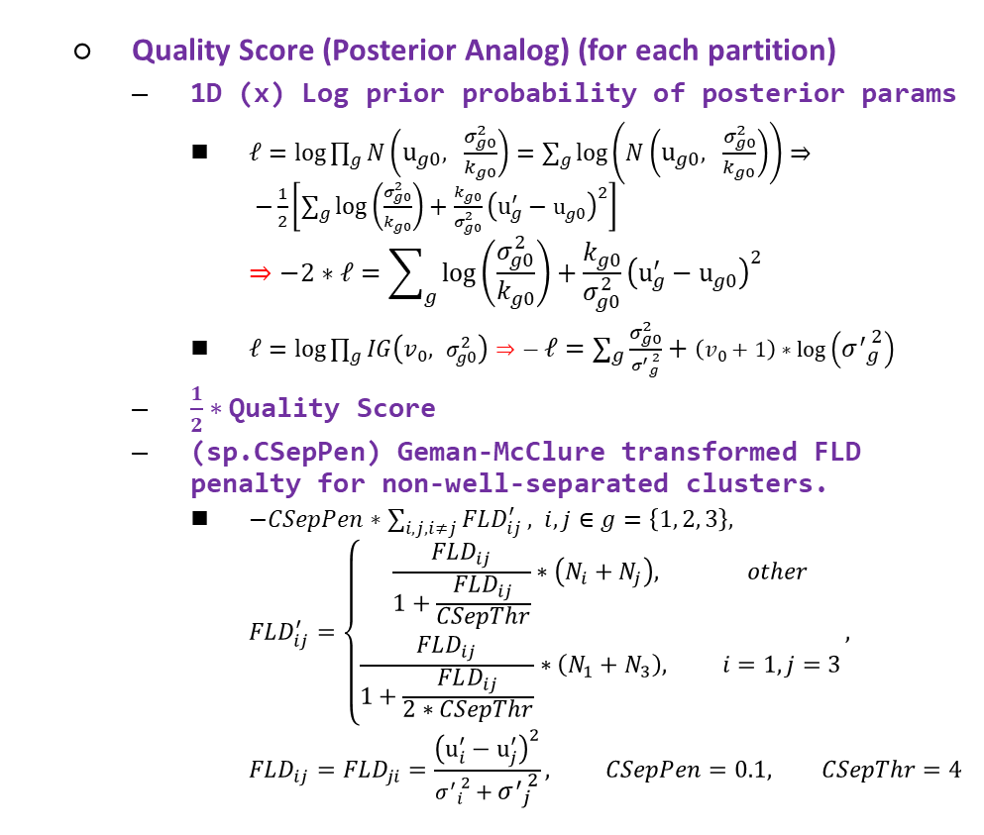
Genotyping Analysis Development and Distribution
Training samples (CEL)
Quality Score (Posterior Analog) (for each partition)
1D (x) Log prior probability of posterior params
$ℓ=log{\prod_{g}{N\left(u_{g0}, \frac{σ_{g0}^{2}}{k_{g0}}\right)}}=\sum_{g}{\log\left(N\left(u_{g0}, \frac{σ_{g0}^{2}}{k_{g0}}\right)\right)}⇒ −\frac{1}{2}\left[\sum_{g}{\log\left(\frac{σ_{g0}^{2}}{k_{g0}}\right)+\frac{k_{g0}}{σ_{g0}^{2}}}{\left(u_{g}^{′}−u_{g0}\right)}^{2}\right]$
$$⇒−2∗ℓ=\sum_{g}{\log\left(\frac{σ_{g0}^{2}}{k_{g0}}\right)+\frac{k_{g0}}{σ_{g0}^{2}}}{\left(u_{g}^{′}−u_{g0}\right)}^{2}$$
$ℓ=log{\prod_{g}{IG\left(v_{0}, σ_{g0}^{2}\right)}}⇒− ℓ=\sum_{g}{\frac{σ_{g0}^{2}}{{σ^{′}}_{g}^{ 2}}+\left(v_{0}+1\right)∗\log\left({σ^{′}}_{g}^{ 2}\right)}$
$\frac{1}{2}∗$ Quality Score
(sp.CSepPen) Geman-McClure transformed FLD penalty for non-well-separated clusters.
$−CSepPen∗\sum_{i,j, i≠j}{FLD_{ij}^{′}}, i, j∈g=\left\{1, 2, 3\right\},$
$$FLD_{ij}^{′}=\left\{\begin{aligned}\frac{FLD_{ij}}{1+\frac{FLD_{ij}}{CSepThr}}∗\left(N_{i}+N_{j}\right), other \\ \frac{FLD_{ij}}{1+\frac{FLD_{ij}}{2∗CSepThr}}∗\left(N_{1}+N_{3}\right), i=1, j=3\end{aligned}\right.,$$
$$FLD_{ij}=FLD_{ji}=\frac{{\left(u_{i}^{′}−u_{j}^{′}\right)}^{2}}{{σ^{′}}_{i}^{ 2}+{σ^{′}}_{j}^{ 2}}, CSepPen=0.1, CSepThr=4$$
Data and Parameters Loader
Target Sketch Estimation
Quantile Normalization
Probe Sets Summarization
Alleles Summarization
Signal Space Transformation (MvA)
GMM Bayesian Update
Genotype Calls and Confidences

Slide 17
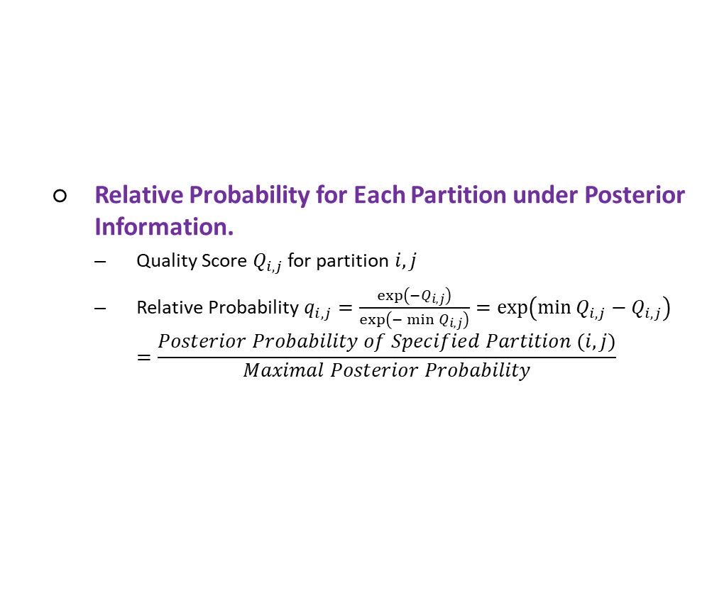
Genotyping Analysis Development and Distribution
Training samples (CEL)
Relative Probability for Each Partition under Posterior Information.
Quality Score $Q_{i, j}$ for partition $i, j$
Relative Probability $q_{i,j}=\frac{\exp\left(−Q_{i, j}\right)}{\exp\left(−\min{Q_{i,j}}\right)}=\exp\left(\min{Q_{i,j}}−Q_{i,j}\right)$
$$=\frac{Posterior Probability of Specified Partition (i,j)}{Maximal Posterior Probability}$$
Data and Parameters Loader
Target Sketch Estimation
Quantile Normalization
Probe Sets Summarization
Alleles Summarization
Signal Space Transformation (MvA)
GMM Bayesian Update
Genotype Calls and Confidences

Slide 18
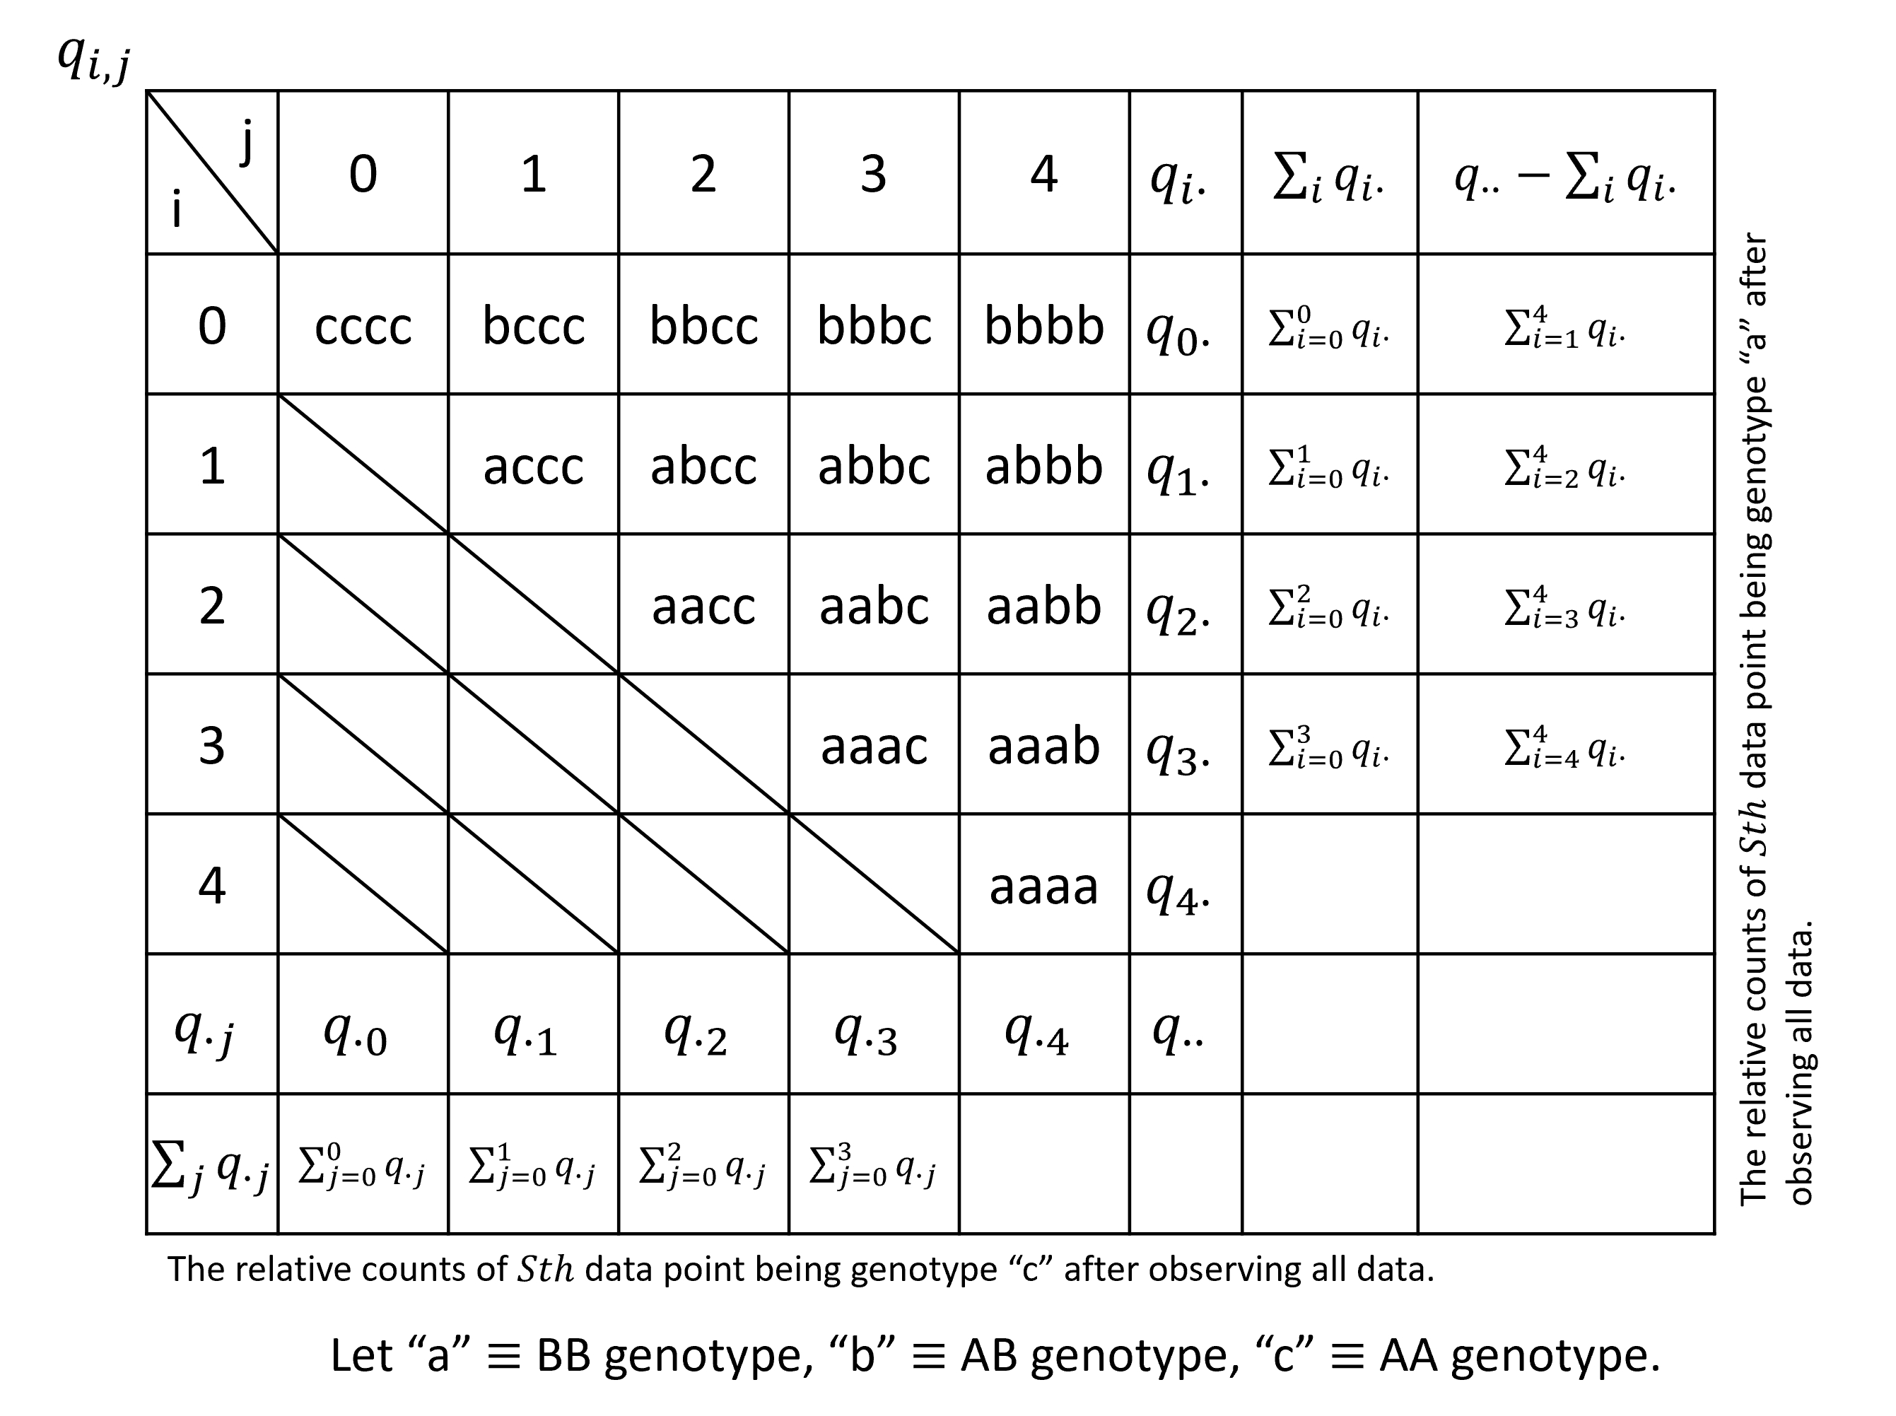
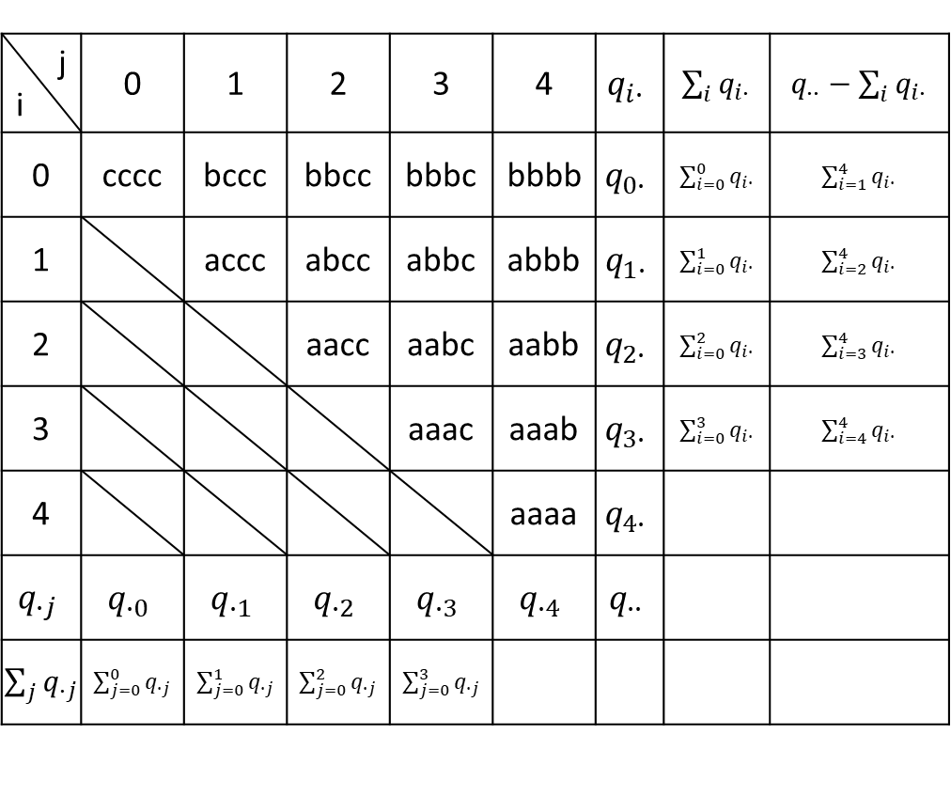
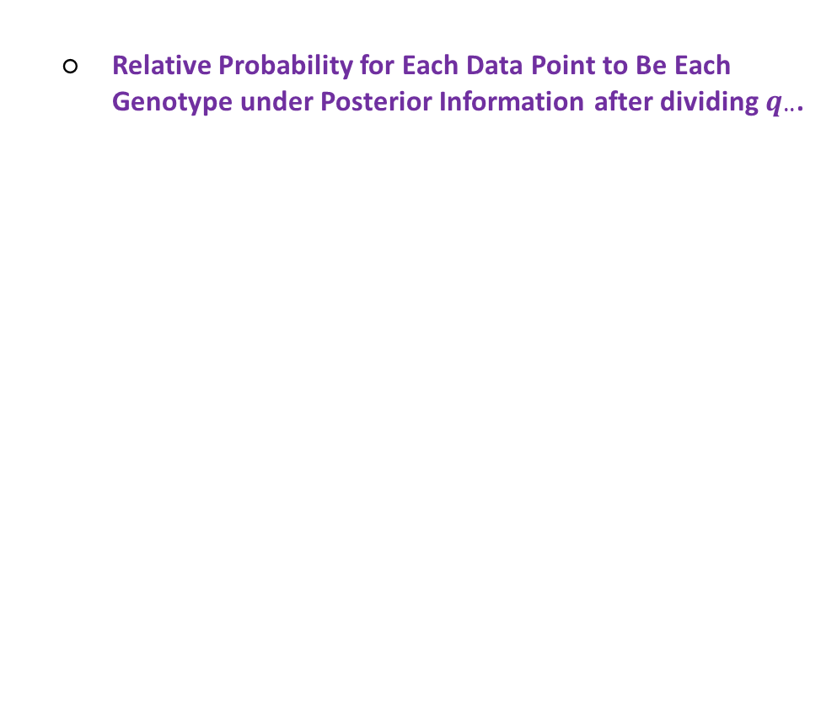
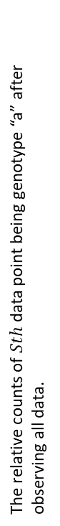
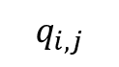
Genotyping Analysis Development and Distribution
Training samples (CEL)
Relative Probability for Each Data Point to Be Each Genotype under Posterior Information after dividing $q_{∙∙}$.
Data and Parameters Loader
Target Sketch Estimation
Quantile Normalization
Probe Sets Summarization
Alleles Summarization
Signal Space Transformation (MvA)
GMM Bayesian Update
Genotype Calls and Confidences
$$q_{i,j}$$
j i | 0 | 1 | 2 | 3 | 4 | $$q_{i∙}$$ | $\sum_{i}{q_{i∙}}$ | $q_{∙∙}−\sum_{i}{q_{i∙}}$
0 | cccc | bccc | bbcc | bbbc | bbbb | $$q_{0∙}$$ | $\sum_{i=0}^{0}{q_{i∙}}$ | $\sum_{i=1}^{4}{q_{i∙}}$
1 |  | accc | abcc | abbc | abbb | $$q_{1∙}$$ | $\sum_{i=0}^{1}{q_{i∙}}$ | $\sum_{i=2}^{4}{q_{i∙}}$
2 |  |  | aacc | aabc | aabb | $$q_{2∙}$$ | $\sum_{i=0}^{2}{q_{i∙}}$ | $\sum_{i=3}^{4}{q_{i∙}}$
3 |  |  |  | aaac | aaab | $$q_{3∙}$$ | $\sum_{i=0}^{3}{q_{i∙}}$ | $\sum_{i=4}^{4}{q_{i∙}}$
4 |  |  |  |  | aaaa | $$q_{4∙}$$
$$q_{∙j}$$ | $$q_{∙0}$$ | $$q_{∙1}$$ | $$q_{∙2}$$ | $$q_{∙3}$$ | $$q_{∙4}$$ | $$q_{∙∙}$$
$\sum_{j}{q_{∙j}}$ | $\sum_{j=0}^{0}{q_{∙j}}$ | $\sum_{j=0}^{1}{q_{∙j}}$ | $\sum_{j=0}^{2}{q_{∙j}}$ | $\sum_{j=0}^{3}{q_{∙j}}$
The relative counts of $Sth$ data point being genotype “a” after observing all data.
The relative counts of $Sth$ data point being genotype “c” after observing all data.
Let “a” $≡$ BB genotype, “b” $≡$ AB genotype, “c” $≡$ AA genotype.

Slide 19
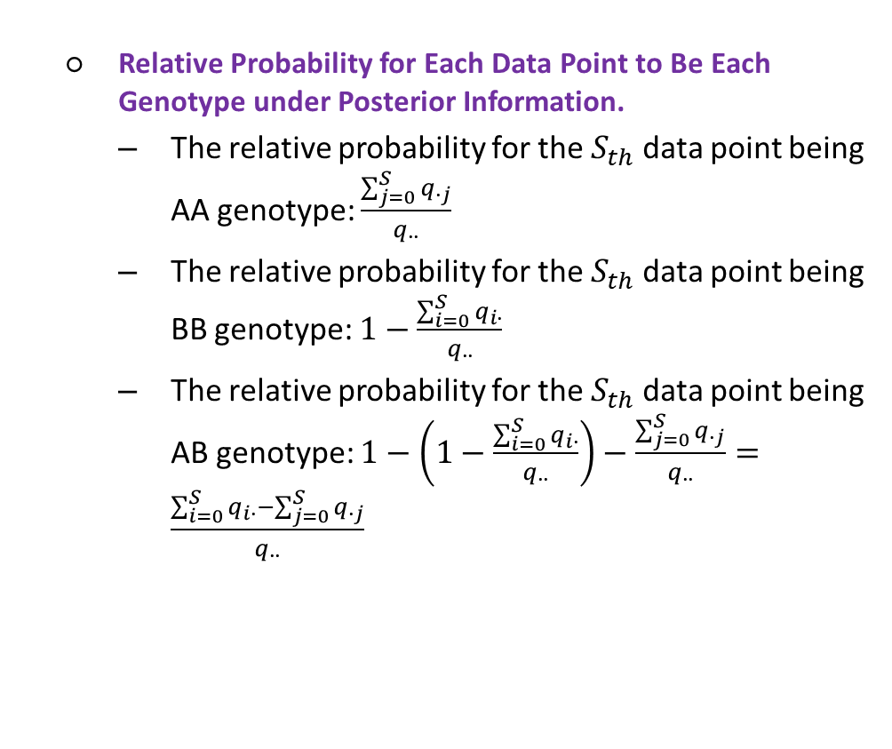
Genotyping Analysis Development and Distribution
Training samples (CEL)
Relative Probability for Each Data Point to Be Each Genotype under Posterior Information.
The relative probability for the $S_{th}$ data point being AA genotype: $\frac{\sum_{j=0}^{S}{q_{∙j}}}{q_{∙∙}}$
The relative probability for the $S_{th}$ data point being BB genotype: $1−\frac{\sum_{i=0}^{S}{q_{i∙}}}{q_{∙∙}}$
The relative probability for the $S_{th}$ data point being AB genotype: $1−\left(1−\frac{\sum_{i=0}^{S}{q_{i∙}}}{q_{∙∙}}\right)−\frac{\sum_{j=0}^{S}{q_{∙j}}}{q_{∙∙}}=\frac{\sum_{i=0}^{S}{q_{i∙}}−\sum_{j=0}^{S}{q_{∙j}}}{q_{∙∙}}$
Data and Parameters Loader
Target Sketch Estimation
Quantile Normalization
Probe Sets Summarization
Alleles Summarization
Signal Space Transformation (MvA)
GMM Bayesian Update
Genotype Calls and Confidences
$$q_{i,j}$$
j i | 0 | 1 | 2 | 3 | 4 | $$q_{i∙}$$ | $\sum_{i}{q_{i∙}}$ | $q_{∙∙}−\sum_{i}{q_{i∙}}$
0 | cccc | bccc | bbcc | bbbc | bbbb | $$q_{0∙}$$ | $\sum_{i=0}^{0}{q_{i∙}}$ | $\sum_{i=1}^{4}{q_{i∙}}$
1 |  | accc | abcc | abbc | abbb | $$q_{1∙}$$ | $\sum_{i=0}^{1}{q_{i∙}}$ | $\sum_{i=2}^{4}{q_{i∙}}$
2 |  |  | aacc | aabc | aabb | $$q_{2∙}$$ | $\sum_{i=0}^{2}{q_{i∙}}$ | $\sum_{i=3}^{4}{q_{i∙}}$
3 |  |  |  | aaac | aaab | $$q_{3∙}$$ | $\sum_{i=0}^{3}{q_{i∙}}$ | $\sum_{i=4}^{4}{q_{i∙}}$
4 |  |  |  |  | aaaa | $$q_{4∙}$$
$$q_{∙j}$$ | $$q_{∙0}$$ | $$q_{∙1}$$ | $$q_{∙2}$$ | $$q_{∙3}$$ | $$q_{∙4}$$ | $$q_{∙∙}$$
$\sum_{j}{q_{∙j}}$ | $\sum_{j=0}^{0}{q_{∙j}}$ | $\sum_{j=0}^{1}{q_{∙j}}$ | $\sum_{j=0}^{2}{q_{∙j}}$ | $\sum_{j=0}^{3}{q_{∙j}}$
The relative counts of $Sth$ data point being genotype “a” after observing all data.
The relative counts of $Sth$ data point being genotype “c” after observing all data.
Let “a” $≡$ BB genotype, “b” $≡$ AB genotype, “c” $≡$ AA genotype.

Slide 20
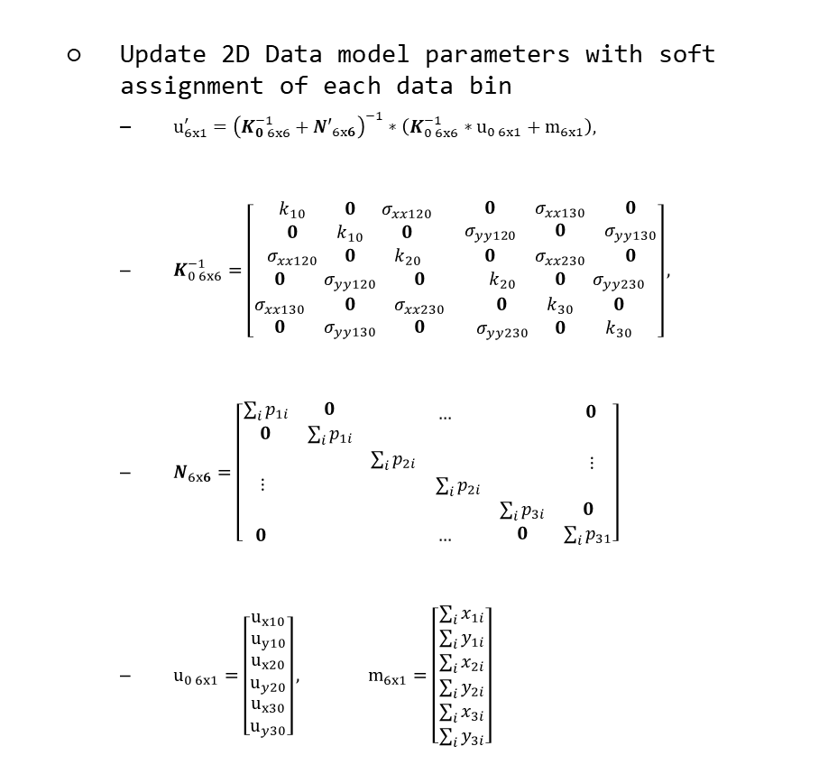
Genotyping Analysis Development and Distribution
Training samples (CEL)
Update 2D Data model parameters with soft assignment of each data bin
$u_{6x1}^{′}={\left(K_{0 6x6}^{−1}+{N′}_{6x6}\right)}^{−1}∗\left(K_{0 6x6}^{−1}∗u_{0 6x1}+m_{6x1}\right),$
$K_{0 6x6}^{−1}=\left[\begin{matrix}\begin{matrix}k_{10} & 0 & σ_{xx120} \\ 0 & k_{10} & 0 \\ σ_{xx120} & 0 & k_{20}\end{matrix} & \begin{matrix}0 & σ_{xx130} & 0 \\ σ_{yy120} & 0 & σ_{yy130} \\ 0 & σ_{xx230} & 0\end{matrix} \\ \begin{matrix}0 & σ_{yy120} & 0 \\ σ_{xx130} & 0 & σ_{xx230} \\ 0 & σ_{yy130} & 0\end{matrix} & \begin{matrix}k_{20} & 0 & σ_{yy230} \\ 0 & k_{30} & 0 \\ σ_{yy230} & 0 & k_{30}\end{matrix}\end{matrix}\right],$
$N_{6x6}=\left[\begin{matrix}\begin{matrix}\sum_{i}{p_{1i}} & 0 \\ 0 & \sum_{i}{p_{1i}}\end{matrix} & \begin{matrix} & … \\ & \end{matrix} & \begin{matrix} & 0 \\ & \end{matrix} \\ \begin{matrix} & \\ ⋮ & \end{matrix} & \begin{matrix}\sum_{i}{p_{2i}} & \\ & \sum_{i}{p_{2i}}\end{matrix} & \begin{matrix} & ⋮ \\ & \end{matrix} \\ \begin{matrix} & \\ 0 & \end{matrix} & \begin{matrix} & \\ & …\end{matrix} & \begin{matrix}\sum_{i}{p_{3i}} & 0 \\ 0 & \sum_{i}{p_{31}}\end{matrix}\end{matrix}\right]$
$u_{0 6x1}=\left[\begin{matrix}\begin{matrix}u_{x10} \\ u_{y10}\end{matrix} \\ \begin{matrix}u_{x20} \\ u_{y20}\end{matrix} \\ \begin{matrix}u_{x30} \\ u_{y30}\end{matrix}\end{matrix}\right], m_{6x1}=\left[\begin{matrix}\begin{matrix}\sum_{i}{x_{1i}} \\ \sum_{i}{y_{1i}}\end{matrix} \\ \begin{matrix}\sum_{i}{x_{2i}} \\ \sum_{i}{y_{2i}}\end{matrix} \\ \begin{matrix}\sum_{i}{x_{3i}} \\ \sum_{i}{y_{3i}}\end{matrix}\end{matrix}\right]$
Data and Parameters Loader
Target Sketch Estimation
Quantile Normalization
Probe Sets Summarization
Alleles Summarization
Signal Space Transformation (MvA)
GMM Bayesian Update
Genotype Calls and Confidences

Slide 21
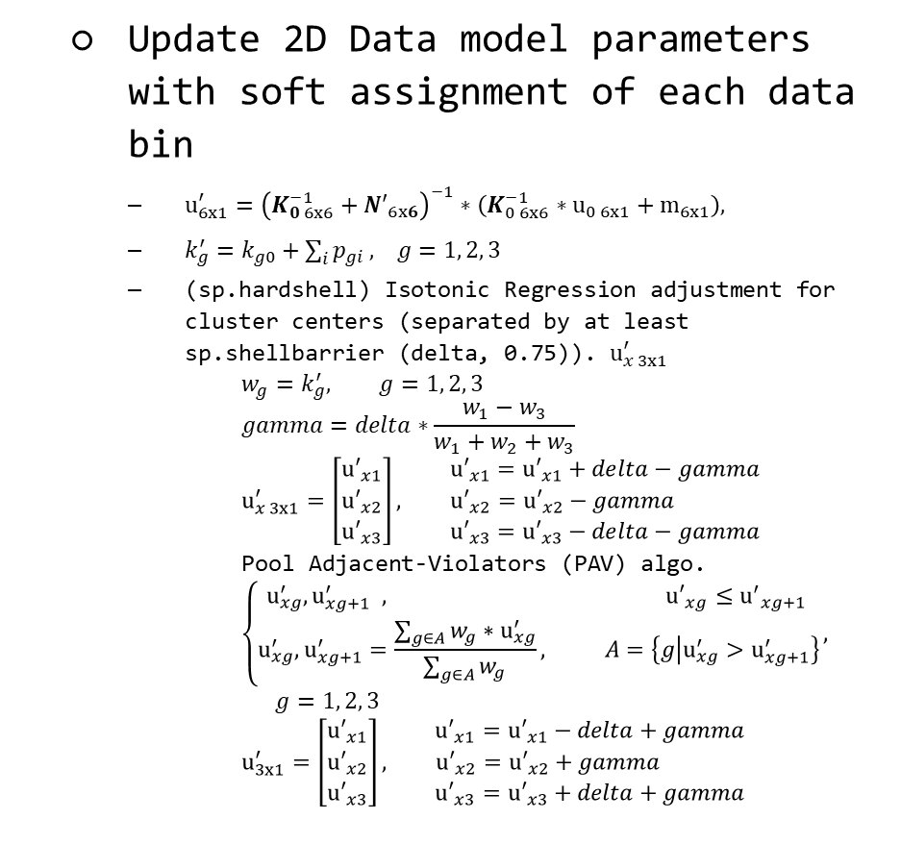
Genotyping Analysis Development and Distribution
Training samples (CEL)
Update 2D Data model parameters with soft assignment of each data bin
$u_{6x1}^{′}={\left(K_{0 6x6}^{−1}+{N′}_{6x6}\right)}^{−1}∗\left(K_{0 6x6}^{−1}∗u_{0 6x1}+m_{6x1}\right),$
$k_{g}^{′}=k_{g0}+\sum_{i}{p_{gi}}, g=1, 2, 3$
(sp.hardshell) Isotonic Regression adjustment for cluster centers (separated by at least sp.shellbarrier (delta, 0.75)). $u_{x 3x1}^{′}$
$$w_{g}=k_{g}^{′}, g=1, 2, 3$$
$$gamma=delta∗\frac{w_{1}−w_{3}}{w_{1}+w_{2}+w_{3}}$$
$$u_{x 3x1}^{′}=\left[\begin{matrix}{u′}_{x1} \\ {u′}_{x2} \\ {u′}_{x3}\end{matrix}\right], \begin{matrix}{u′}_{x1}={u′}_{x1}+delta−gamma \\ {u′}_{x2}={u′}_{x2}−gamma \\ {u′}_{x3}={u′}_{x3}−delta−gamma\end{matrix}$$
Pool Adjacent-Violators (PAV) algo.
$$\left\{\begin{aligned}u_{xg}^{′}, u_{xg+1}^{′} , {u′}_{xg}≤{u^{′}}_{xg+1} \\ u_{xg}^{′}, u_{xg+1}^{′}=\frac{\sum_{g∈A}{w_{g}}∗u_{xg}^{′}}{\sum_{g∈A}{w_{g}}}, A=\left\{g | u_{xg}^{′}>u_{xg+1}^{′}\right\}\end{aligned}\right.,$$
$$g=1, 2, 3$$
$$u_{3x1}^{′}=\left[\begin{matrix}{u′}_{x1} \\ {u′}_{x2} \\ {u′}_{x3}\end{matrix}\right], \begin{matrix}{u′}_{x1}={u′}_{x1}−delta+gamma \\ {u′}_{x2}={u′}_{x2}+gamma \\ {u′}_{x3}={u′}_{x3}+delta+gamma\end{matrix}$$
Data and Parameters Loader
Target Sketch Estimation
Quantile Normalization
Probe Sets Summarization
Alleles Summarization
Signal Space Transformation (MvA)
GMM Bayesian Update
Genotype Calls and Confidences

Slide 22
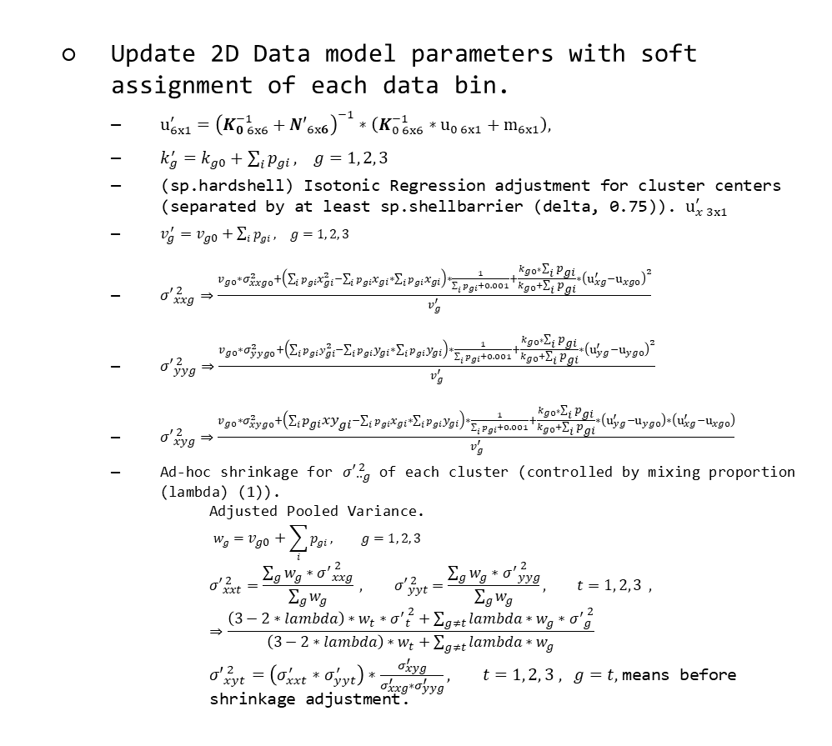
Genotyping Analysis Development and Distribution
Training samples (CEL)
Update 2D Data model parameters with soft assignment of each data bin.
$u_{6x1}^{′}={\left(K_{0 6x6}^{−1}+{N′}_{6x6}\right)}^{−1}∗\left(K_{0 6x6}^{−1}∗u_{0 6x1}+m_{6x1}\right),$
$k_{g}^{′}=k_{g0}+\sum_{i}{p_{gi}}, g=1, 2, 3$
(sp.hardshell) Isotonic Regression adjustment for cluster centers (separated by at least sp.shellbarrier (delta, 0.75)). $u_{x 3x1}^{′}$
$v_{g}^{′}=v_{g0}+\sum_{i}{p_{gi}}, g=1, 2, 3$
${σ′}_{xxg}^{ 2}⇒\frac{v_{g0}∗σ_{xxg0}^{2}+\left(\sum_{i}{{p_{gi}x}_{gi}^{2}}−\sum_{i}{p_{gi}x_{gi}}∗\sum_{i}{p_{gi}x_{gi}}\right)∗\frac{1}{\sum_{i}{p_{gi}}+0.001}+\frac{k_{g0}∗\sum_{i}{p_{gi}}}{k_{g0}+\sum_{i}{p_{gi}}}∗{\left(u_{xg}^{′}−u_{xg0}\right)}^{2}}{v_{g}^{′}}$
${σ′}_{yyg}^{ 2}⇒\frac{v_{g0}∗σ_{yyg0}^{2}+\left(\sum_{i}{{p_{gi}y}_{gi}^{2}}−\sum_{i}{p_{gi}y_{gi}}∗\sum_{i}{p_{gi}y_{gi}}\right)∗\frac{1}{\sum_{i}{p_{gi}}+0.001}+\frac{k_{g0}∗\sum_{i}{p_{gi}}}{k_{g0}+\sum_{i}{p_{gi}}}∗{\left(u_{yg}^{′}−u_{yg0}\right)}^{2}}{v_{g}^{′}}$
${σ′}_{xyg}^{ 2}⇒\frac{v_{g0}∗σ_{xyg0}^{2}+\left(\sum_{i}{p_{gi}xy_{gi}}−\sum_{i}{p_{gi}x_{gi}}∗\sum_{i}{p_{gi}y_{gi}}\right)∗\frac{1}{\sum_{i}{p_{gi}}+0.001}+\frac{k_{g0}∗\sum_{i}{p_{gi}}}{k_{g0}+\sum_{i}{p_{gi}}}∗\left(u_{yg}^{′}−u_{yg0}\right)∗\left(u_{xg}^{′}−u_{xg0}\right)}{v_{g}^{′}}$
Ad-hoc shrinkage for ${σ′}_{∙∙g}^{ 2}$ of each cluster (controlled by mixing proportion (lambda) (1)).
Adjusted Pooled Variance.
$$w_{g}=v_{g0}+\sum_{i}{p_{gi}}, g=1, 2, 3$$
$${σ′}_{xxt}^{ 2}=\frac{\sum_{g}{w_{g}∗{σ^{′}}_{xxg}^{ 2}}}{\sum_{g}{w_{g}}} , {σ′}_{yyt}^{ 2}=\frac{\sum_{g}{w_{g}∗{σ^{′}}_{yyg}^{ 2}}}{\sum_{g}{w_{g}}}, t=1, 2, 3 , ⇒\frac{\left(3−2∗lambda\right)∗w_{t}∗{σ^{′}}_{t}^{ 2}+\sum_{g≠t}{lambda∗w_{g}∗{σ^{′}}_{g}^{ 2}}}{\left(3−2∗lambda\right)∗w_{t}+\sum_{g≠t}{lambda∗w_{g}}}$$
${σ′}_{xyt}^{ 2}=\left(σ_{xxt}^{′}∗σ_{yyt}^{′}\right)∗\frac{σ_{xyg}^{′}}{σ_{xxg}^{′}∗σ_{yyg}^{′}}, t=1, 2, 3 , g=t,$means before shrinkage adjustment.
Data and Parameters Loader
Target Sketch Estimation
Quantile Normalization
Probe Sets Summarization
Alleles Summarization
Signal Space Transformation (MvA)
GMM Bayesian Update
Genotype Calls and Confidences

Slide 23
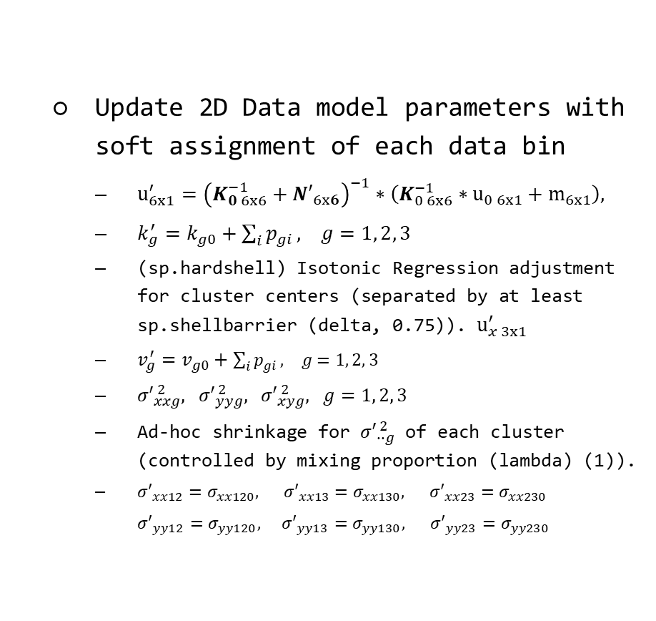
Genotyping Analysis Development and Distribution
Training samples (CEL)
Update 2D Data model parameters with soft assignment of each data bin
$u_{6x1}^{′}={\left(K_{0 6x6}^{−1}+{N′}_{6x6}\right)}^{−1}∗\left(K_{0 6x6}^{−1}∗u_{0 6x1}+m_{6x1}\right),$
$k_{g}^{′}=k_{g0}+\sum_{i}{p_{gi}}, g=1, 2, 3$
(sp.hardshell) Isotonic Regression adjustment for cluster centers (separated by at least sp.shellbarrier (delta, 0.75)). $u_{x 3x1}^{′}$
$v_{g}^{′}=v_{g0}+\sum_{i}{p_{gi}}, g=1, 2, 3$
${σ′}_{xxg}^{ 2}, {σ′}_{yyg}^{ 2}, {σ′}_{xyg}^{ 2}, g=1, 2, 3$
Ad-hoc shrinkage for ${σ′}_{∙∙g}^{ 2}$ of each cluster (controlled by mixing proportion (lambda) (1)).
${{σ′}_{xx12}=σ}_{xx120}, {{σ′}_{xx13}=σ}_{xx130}, {{σ′}_{xx23}=σ}_{xx230}$
${{σ′}_{yy12}=σ}_{yy120}, {{σ′}_{yy13}=σ}_{yy130}, {{σ′}_{yy23}=σ}_{yy230}$
Data and Parameters Loader
Target Sketch Estimation
Quantile Normalization
Probe Sets Summarization
Alleles Summarization
Signal Space Transformation (MvA)
GMM Bayesian Update
Genotype Calls and Confidences

Slide 24
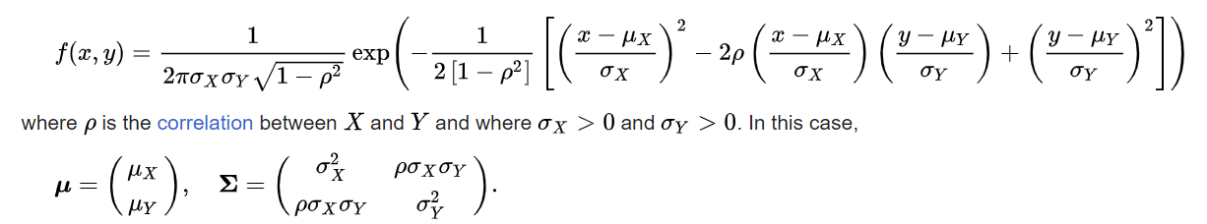
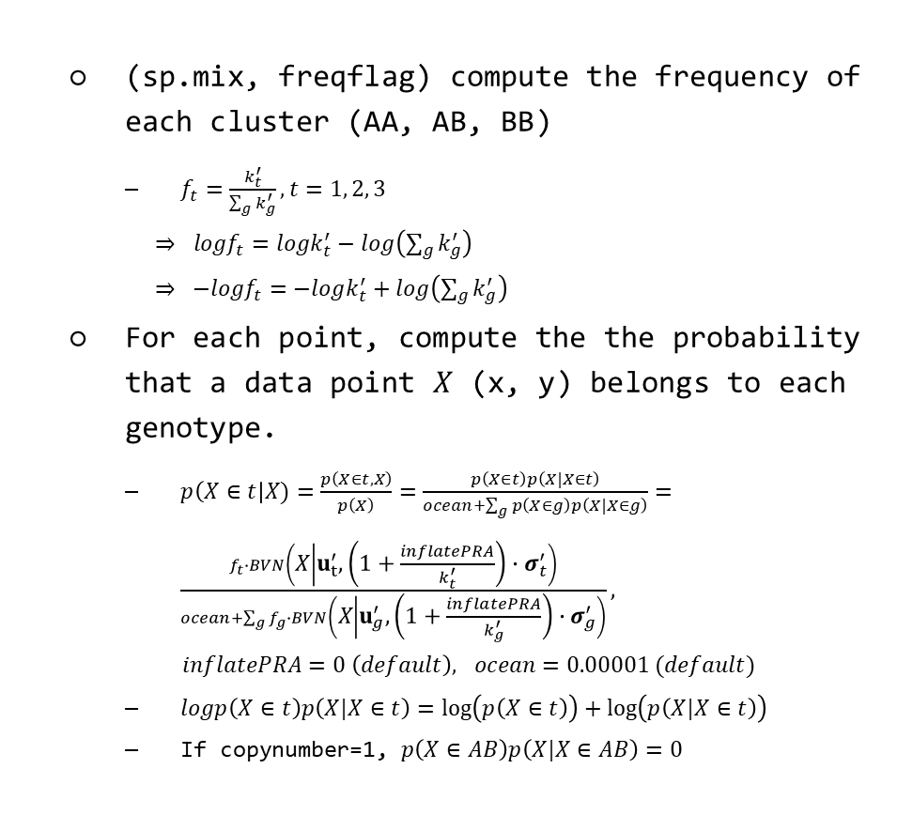
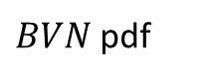
Genotyping Analysis Development and Distribution
(sp.mix, freqflag) compute the frequency of each cluster (AA, AB, BB)
$f_{t}=\frac{k_{t}^{′}}{\sum_{g}{k_{g}^{′}}}, t=1, 2, 3$
$⇒ logf_{t}=logk_{t}^{′}−log\left(\sum_{g}{k_{g}^{′}}\right)$
$⇒ −logf_{t}=−logk_{t}^{′}+log\left(\sum_{g}{k_{g}^{′}}\right)$
For each point, compute the the probability that a data point $X$ (x, y) belongs to each genotype.
$p\left(X∈t\right|X)=\frac{p\left(X∈t,X\right)}{p\left(X\right)}=\frac{p\left(X∈t\right)p\left(X|X∈t\right)}{ocean+\sum_{g}{p\left(X∈g\right)p\left(X|X∈g\right)}}=\frac{f_{t}∙BVN\left(X | u_{t}^{′}, \left(1+\frac{inflatePRA}{k_{t}^{′}}\right)∙σ_{t}^{′}\right)}{ocean+\sum_{g}{f_{g}∙BVN\left(X | u_{g}^{′},\left(1+\frac{inflatePRA}{k_{g}^{′}}\right)∙σ_{g}^{′}\right)}},$
$inflatePRA=0 \left(default\right), ocean=0.00001 (default)$
$logp\left(X∈t\right)p\left(X|X∈t\right)=\log\left(p\left(X∈t\right)\right)+\log\left(p\left(X|X∈t\right)\right)$
If copynumber=1, $p\left(X∈AB\right)p\left(X|X∈AB\right)=0$
Training samples (CEL)
Data and Parameters Loader
Target Sketch Estimation
Quantile Normalization
Probe Sets Summarization
Alleles Summarization
Signal Space Transformation (MvA)
GMM Bayesian Update
Genotype Calls and Confidences
$BVN$pdf

Slide 25
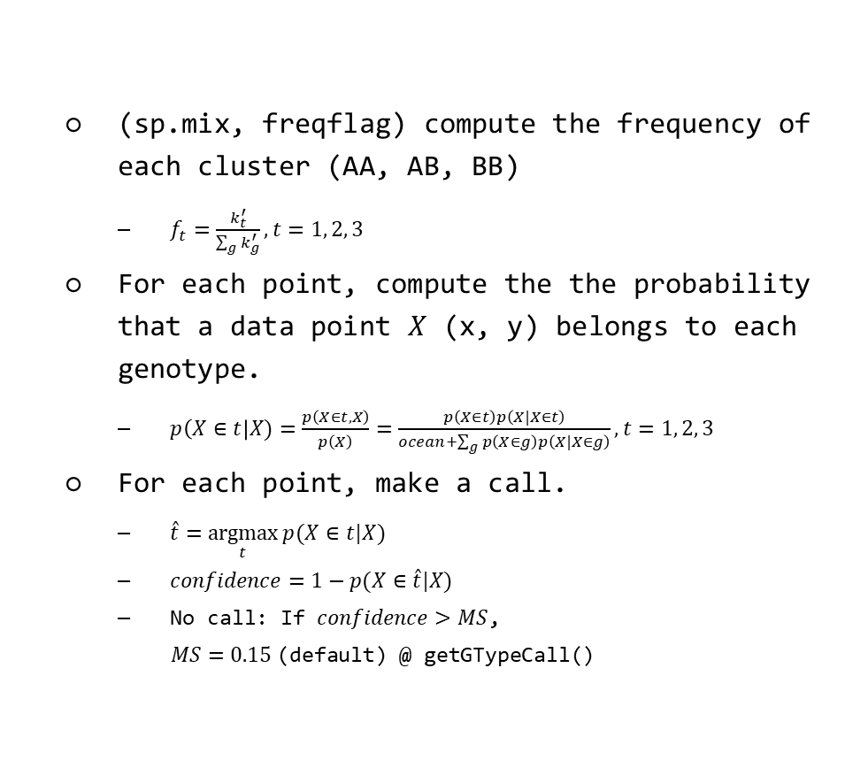
Genotyping Analysis Development and Distribution
Training samples (CEL)
(sp.mix, freqflag) compute the frequency of each cluster (AA, AB, BB)
$f_{t}=\frac{k_{t}^{′}}{\sum_{g}{k_{g}^{′}}}, t=1, 2, 3$
For each point, compute the the probability that a data point $X$ (x, y) belongs to each genotype.
$p\left(X∈t\right|X)=\frac{p\left(X∈t,X\right)}{p\left(X\right)}=\frac{p\left(X∈t\right)p\left(X|X∈t\right)}{ocean+\sum_{g}{p\left(X∈g\right)p\left(X|X∈g\right)}}, t=1, 2, 3$
For each point, make a call.
$\hat{t}=\underset{t}{argmax}{p(X∈t|X)}$
$confidence=1−p(X∈\hat{t}|X)$
No call: If $confidence>MS$,
$MS=0.15$(default) @ getGTypeCall()
Data and Parameters Loader
Target Sketch Estimation
Quantile Normalization
Probe Sets Summarization
Alleles Summarization
Signal Space Transformation (MvA)
GMM Bayesian Update
Genotype Calls and Confidences

Slide 26
Genotyping Analysis Development and Distribution
Evaluation Data: GSE78098
Platform: GPL21480 (Axiom_GW_Hu-CHB_SNP)
Focus on Chinese (Asian) people.
420 human samples
639653 Probe sets
Preprocessing and filter by DQC < 0.82
All 419 samples are picked.
Evaluation Data: Dog Banff
Platform: B1C (Banff)
187 dog samples
48283 Probe sets
Preprocessing for channel name, vcf allele definition, and change the coordinate system for the Y axis of the heatmap.
QC filter by NP probes performance (e.g. NP call rate, NP call slope).
155 dog samples are finally picked and used to build genotyping models.
Manual, Reports & Results: Project-CPT/CPT.wiki/AxiomGT.md at main · jeff665547/Project-CPT (github.com)
Notes:
Channel name caused by hdf5
VCF definition failure: correct => A: ref, B: alt
Image convert to heatmap: Y need to be inversed.

Slide 27
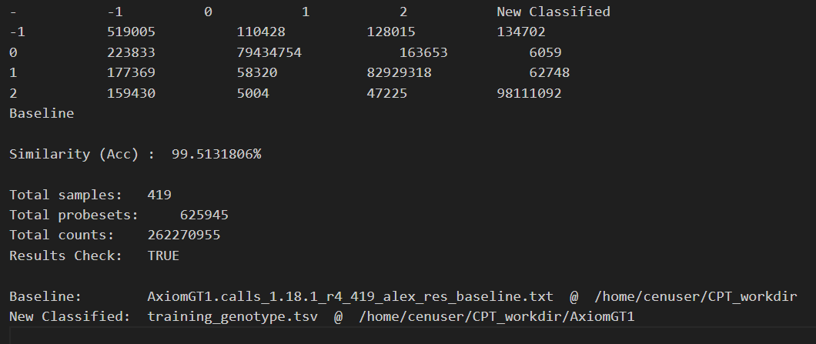
Genotyping Analysis Development and Distribution
Genotype Classification Results
 | -1 | 0 | 1 | 2
-1 | 519005 | 110428 | 128015 | 134702
0 | 223833 | 79434754 | 163653 | 6509
1 | 177369 | 58320 | 82929318 | 62748
2 | 159430 | 5004 | 47225 | 98111092
Similarity (Acc.): 99.5131806%
CPT
APT
Current progress
* Refine quantile normalization
* Model research and improvement
* Evaluation methods research and optimization
* Genotype labeling optimization

Slide 28
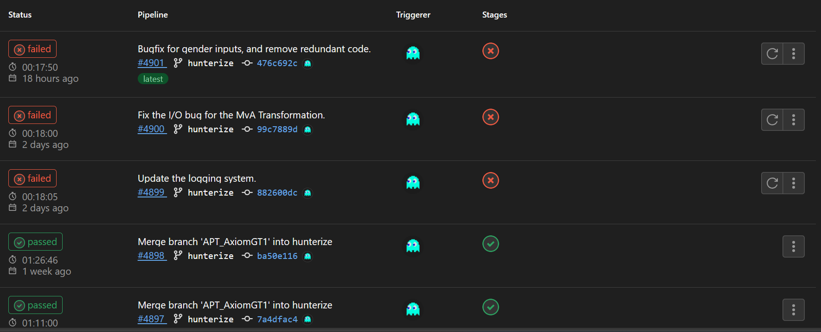
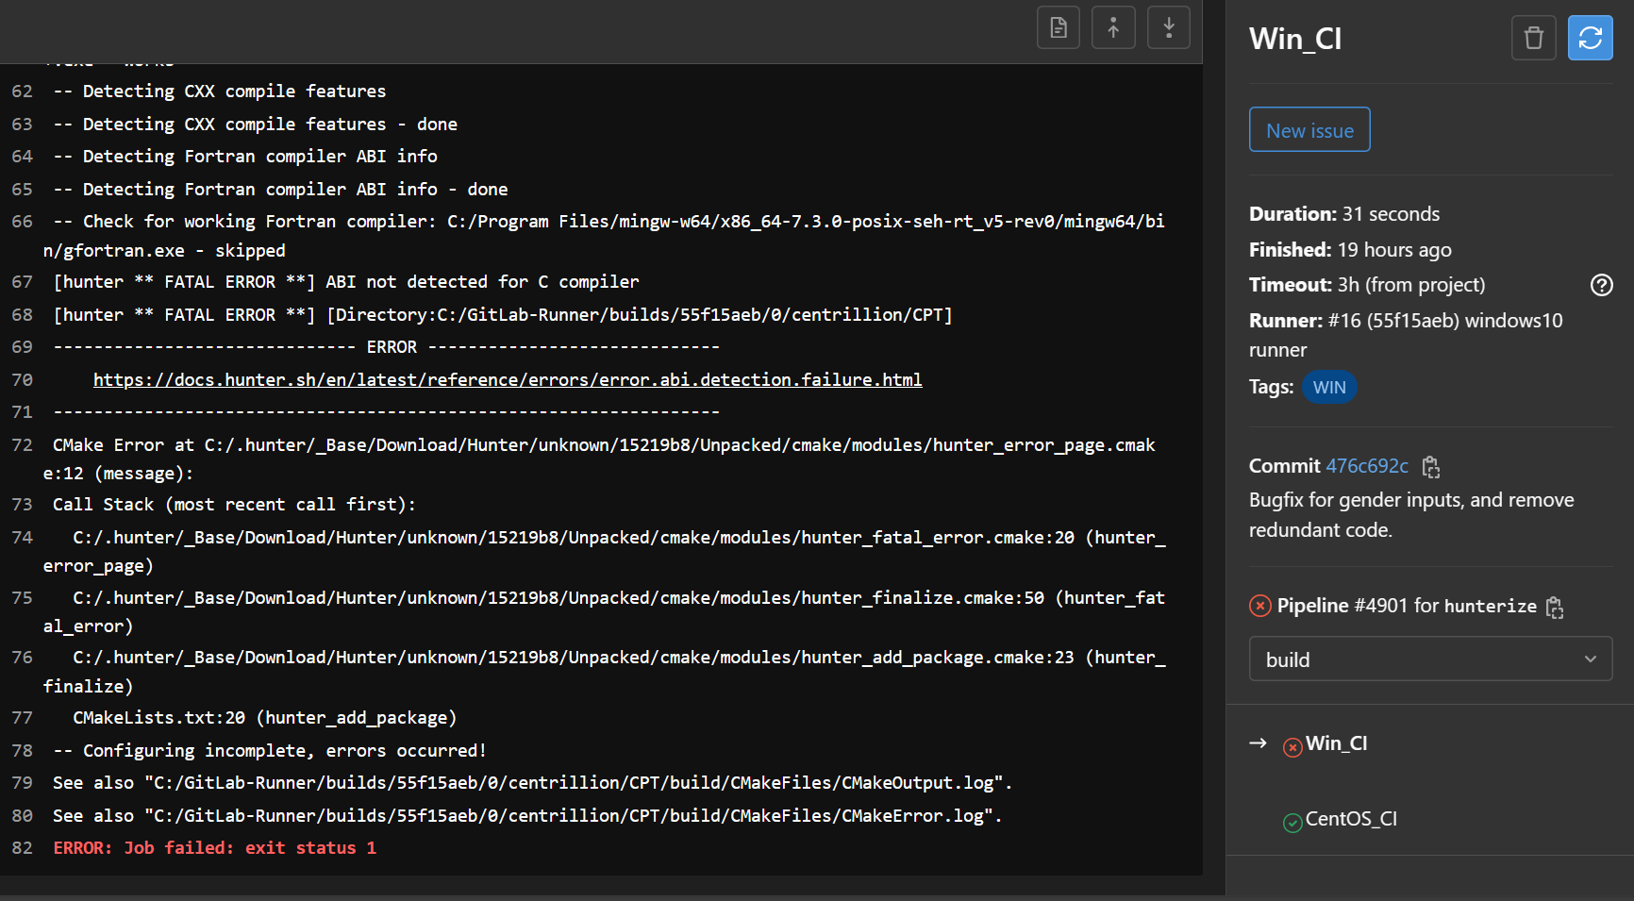
Genotyping Analysis Development and Distribution
Bugfix for the CI/CD error when deployment and distribution.
Notes:
Channel name caused by hdf5
VCF definition failure: correct => A: ref, B: alt
Image convert to heatmap: Y need to be inversed.

Slide 29
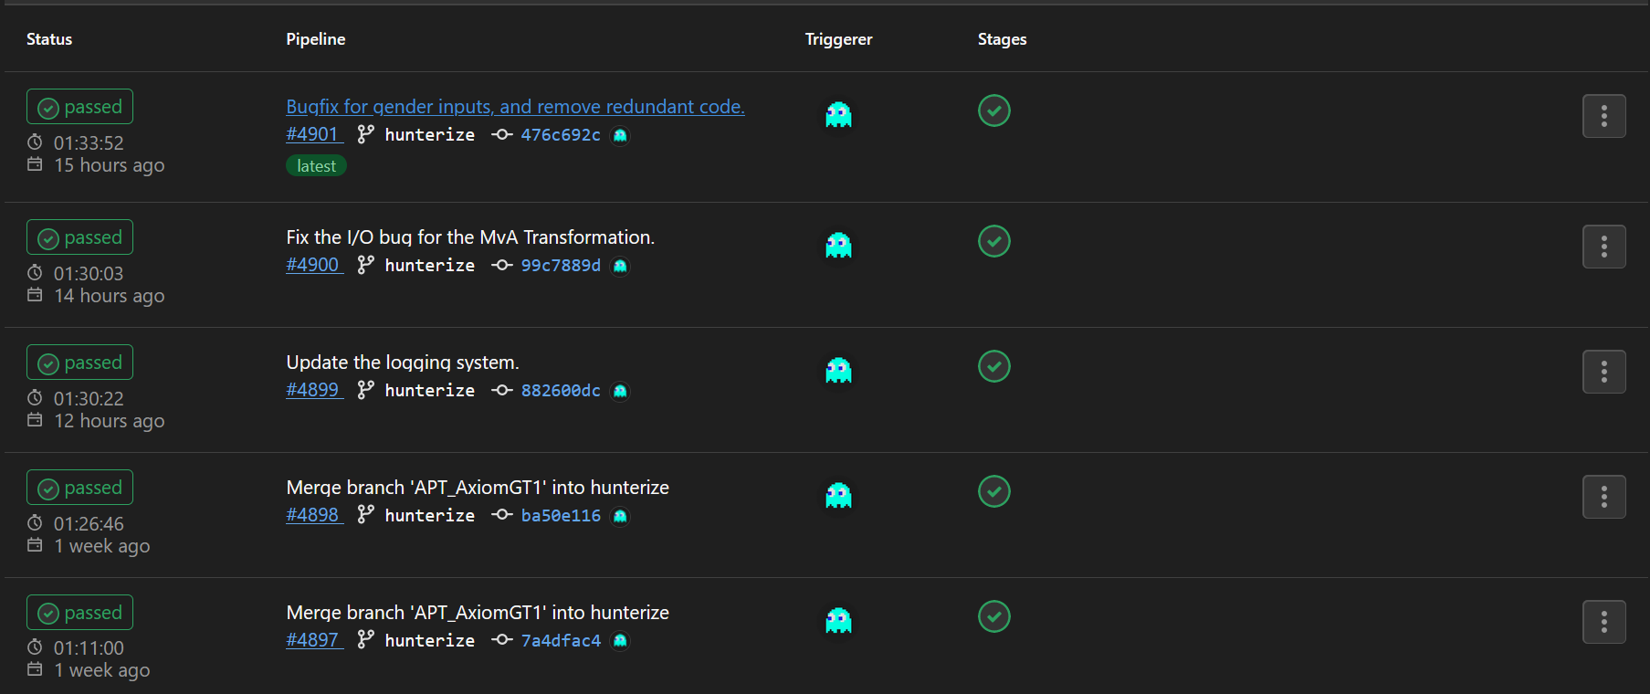
Genotyping Analysis Development and Distribution
Successful deployment and distribution.
Notes:
Channel name caused by hdf5
VCF definition failure: correct => A: ref, B: alt
Image convert to heatmap: Y need to be inversed.

Slide 30
Other Genotyping Models Research and Development
Jeff (CHI-HSUAN HO)

Slide 31
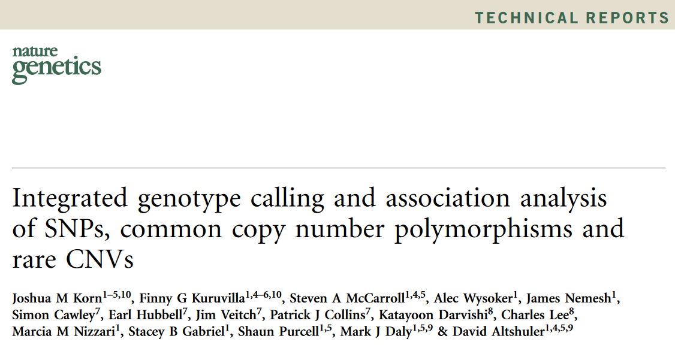
Progress Report and Future Work
Birdseed Framework
Training samples (CEL)
Data Loader
Target Sketch Estimation
Quantile Normalization
Allele Summarization
Signal Space Transformation
Birdseed/BRLMMp<Train>

Slide 32
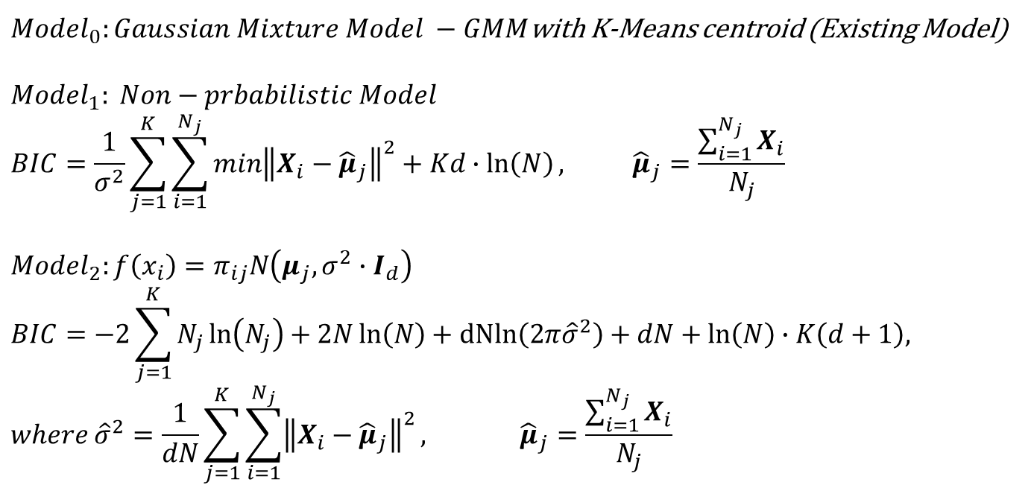
Genotyping Methods Evaluation and Simulation
Birdseed: K-means training model
$Model_{0}:Gaussian Mixture Model −GMM$with K-Means centroid (Existing Model)
$$Model_{1}: Non−prbabilistic Model$$
$$BIC=\frac{1}{σ^{2}}\sum_{j=1}^{K}{\sum_{i=1}^{N_{j}}{\min{{\left\|X_{i}−{\hat{μ}}_{j}\right\|}^{2}}}}+Kd∙\ln\left(N\right), {\hat{μ}}_{j}=\frac{\sum_{i=1}^{N_{j}}{X_{i}}}{N_{j}}$$
$$Model_{2}:f\left(x_{i}\right)=π_{ij}N\left(μ_{j},σ^{2}∙I_{d}\right)$$
$$BIC=−2\sum_{j=1}^{K}{N_{j}\ln\left(N_{j}\right)}+2N\ln\left(N\right)+dNln\left(2π{\hat{σ}}^{2}\right)+dN+\ln\left(N\right)∙K\left(d+1\right),$$
$$where {\hat{σ}}^{2}=\frac{1}{dN}\sum_{j=1}^{K}{\sum_{i=1}^{N_{j}}{{\left\|X_{i}−{\hat{μ}}_{j}\right\|}^{2}}}, {\hat{μ}}_{j}=\frac{\sum_{i=1}^{N_{j}}{X_{i}}}{N_{j}}$$

Slide 33
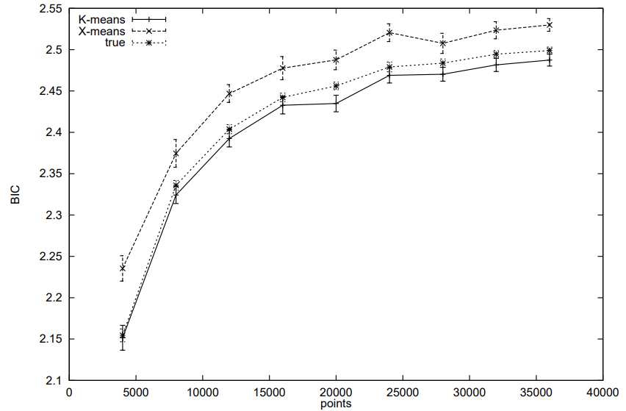
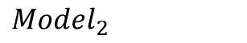
Genotyping Methods Evaluation and Simulation
-
$$Model_{2}$$

Slide 34

Genotyping Methods Evaluation and Simulation
Birdseed: K-means training model
$Model_{3}: ANOVA: X_{it}=μ_{it}+E_{it}, μ∈ℝ^{nxd}, E∈ℝ^{nxd}, E_{it} \sim iid N\left(0,σ^{2}\right), i=1, 2,…,N, t=1, 2, …, d$
$$BIC=Nd∙\ln\left(\sum_{j=1}^{K}{\sum_{i=1}^{N_{j}}{{\left\|X_{i}−{\hat{μ}}_{j}\right\|}^{2}}}\right)+Nd\left(1+\ln\left(\frac{2π}{Nd}\right)\right)$$
$+\ln\left(Nd\right)∙\left[Kd+\frac{1}{\tilde{σ}}\sum_{j=1}^{K^{′}}{\sum_{i=1}^{\tilde{N_{j}}}{\sum_{t=1}^{d}{\sum_{l≠c\left(i\right)}{φ\left(\frac{X_{i,t} + δ_{l}^{i,t} − {\tilde{μ}}_{i,t}}{\tilde{σ}}\right)}}}}∙\lim_{γ⇄δ_{l}^{i, t}}{ℳ{\left(X+γe_{i,t}\right)}_{i,t}}\right],$
$where {\tilde{σ}}^{2}=\frac{1}{dN}\sum_{j=1}^{K^{′}}{\sum_{i=1}^{\tilde{N_{j}}}{{\left\|X_{i}−{\tilde{μ}}_{i}\right\|}^{2}}}, \tilde{μ}=ℳ\left(X;K^{′}\right)$ for some $K^{′}>K,$
$φ\left(∙\right)$is the pdf of Normal (Gaussian) distribution,
$\lim_{γ⇄δ_{l}^{i, t}}{ℳ{\left(X+γe_{i,t}\right)}_{i,t}}={\left(−1\right)}^{I_{\left\{δ_{l}^{i, t}>0\right\}}}\left({\hat{μ}}_{c\left(i\right), t}−\frac{N_{l}}{N_{l}+1}{\hat{μ}}_{l, t}−\frac{X_{i,t}}{N_{l}+1}+δ_{l}^{i, t}\left(\frac{N_{l}+1−N_{c\left(i\right)}}{\left(N_{l}+1\right) ∙ N_{c\left(i\right)}}\right)\right)$,
$c\left(i\right)={argmin}_{lε\left\{1, 2, …, K\right\}}{\left\|X_{i}−{\hat{μ}}_{l}\right\|}^{2}$,
$\left(1−{\left(\frac{N_{c\left(i\right)}−1}{N_{c\left(i\right)}}\right)}^{2}\right){δ_{l}^{i, t}}^{2}+2∙\left(\left(X_{i,t}−{\hat{μ}}_{l, t}\right)−\left(X_{i,t}−{\hat{μ}}_{c\left(i\right), t}\right)∙\left(\frac{N_{c\left(i\right)}−1}{N_{c\left(i\right)}}\right)\right)δ_{l}^{i, t}+{\left(X_{i,t}−{\hat{μ}}_{l, t}\right)}^{2}−{\left(X_{i,t}−{\hat{μ}}_{c\left(i\right), t}\right)}^{2}=0$

Slide 35



Genotyping Methods Evaluation and Simulation
$$Model_{3}$$

Slide 36




Genotyping Methods Evaluation and Simulation
Birdseed: K-means training model
$Model_{0}:Equal weight Before scale: 94.1908\%$
$$Model_{0}:But differnet weight Before scale − Default \left(trim BIC, trim Fan\right):84.6841\% with very highly lose−classified rate.$$
$$Model_{0}:But differnet weight Before scale−no trim BIC:90.8778\%$$
$$Model_{0}:But differnet weight Before scale−no trim Fan:0\%$$
$$Model_{1}: Before scale − Default \left(trim BIC, trim Fan\right):98.3863\% with very highly lose−classified rate.$$
$$Model_{1}: Before scale −no trim BIC:98.6603\% →98.7585\% (BIC under all data)$$
$$Model_{1}: Before scale −no trim Fan:98.4763\%$$
$$Model_{1}: After scale:94.3179\%$$

Slide 37





Genotyping Methods Evaluation and Simulation
Simulation
sol$k: $Model_{3}$
sol$k_: $Model_{1}: Before scale$
Ans: $k=2$

Slide 38


Genotyping Methods Evaluation and Simulation
Simulation
sol$k: $Model_{3}$
sol$k_: $Model_{1}: Before scale$
$$\text{Ans}\text{: }k=3$$

